Slide 1



Slide 2

Scripting Languages:
A high-level programming language that is interpreted by another program at runtime rather than compiled by the computer's processor as other programming languages (such as C and C++) are.
Scripting language (also known as scripting, or script) is a series of commands that are able to be executed without the need for compiling.
While all scripting languages are programming languages, not all programming languages are scripting languages.
Scripting languages use a program known as an interpreter to translate commands and are directly interpreted from source code, not requiring a compilation step.
Other programming languages, on the other hand, may require a compiler to translate commands into machine code before it can execute those commands.
PHP, Perl, and Python are common examples of scripting languages.
Scripting languages, which can be embedded within HTML, commonly are used to add functionality to a Web page, such as different menu styles or graphic displays or to serve dynamic advertisements.

Slide 3
Types of Scripting Languages
Server Side Scripting and Client Side Scripting:
Server-side scripting languages run on a web server.
When a client sends a request, the server responds by sending content via HTTP.
In contrast, client-side scripting languages run on the client end—on their web browser.
The benefit of client-side scripts is that they can reduce demand on the server, allowing web pages to load faster.
Whereas, one significant benefit of server-side scripts is they are not viewable by the public like client-side scripts are.
When trying to decide which way to go on a project, keep in mind that client-side scripting is more focused on user interface and functionality.
Conversely, server-side scripting focuses on faster processing, access to data, and resolving errors.

Slide 4
Types of Scripting Languages
Server-side Scripting Language
Can use huge resources of the server
Complete all processing in the server and send plain pages to the client
Reduces client-side computation overhead
server-side scripting languages that manipulate the data, usually in a database, on the server.
Client-side Scripting Language
Does not involve server processing
Complete application is downloaded to the client browser
Client browser executes it locally
Are normally used to add functionality to web pages e.g. different menu styles, graphic displays or dynamic advertisements
client-side scripting languages, affecting the data that the end user sees in a browser window.

Slide 5
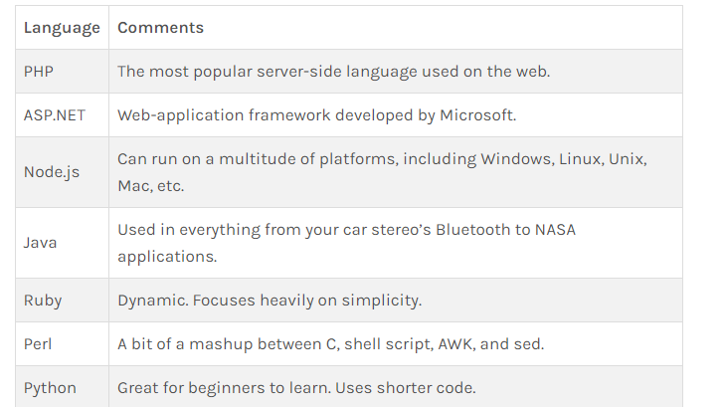
Different Scripting Languages
Examples of Server-Side Scripting Languages

Slide 6
Client Side Scripting Languages
VBScript
  Microsoft’s scripting language
  Client side Scripting language
  Very easy to learn
  Includes the functionality of Visual Basic
JavaScript
  Client-side Scripting language
  Easy to use programming language
  Enhance dynamics and interactive features of a web page
  Allows to perform calculation, write interactive games, add special effects, customize graphic selections, create security passwords

Slide 7
What is DHTML
Generally, DHTML refers to applications that allow a Web page to change dynamically without requiring information to be passed to/from a web server.
More specifically, DHTML refers to the interaction of HTML, CSS and Scripting language (JavaScript).
Crucial component of DHTML is DOM (Document Object Model)
DHTML = HTML + CSS + JavaScript + DOM

Slide 8
Use of DHML
To make Web pages interactive.
HTML pages have static nature.
DHTML provides us with enhanced creative control so we can manipulate any page element at any time.
It is the easiest way to make Web pages interactive.
It doesn’t increase server workload and require special software to support.

Slide 9
What is JavaScript?
JavaScript was designed to add interactivity to HTML pages.
JavaScript is a scripting language.
JavaScript usually runs on the client-side (the browser's side).
A scripting language is a lightweight programming language.
JavaScript is usually embedded directly into HTML pages interpreted by browser.
JavaScript is an interpreted language (means that scripts execute without preliminary compilation)

Slide 10
• NOT Java
  – JavaScript was developed by Netscape
  – Java was developed by Sun
• Designed to ‘plug a gap’ in the techniques
available for creating web-pages
  – Client-side dynamic content
• Interpreted

Slide 11
What Can JavaScript do?
JavaScript gives HTML designers a programming tool
JavaScript can react to events - A JavaScript can be set to execute when something happens, like when a page has finished loading or when a user clicks on an HTML element
JavaScript can read and write HTML elements - A JavaScript can read and change the content of an HTML element

Slide 12
What Can JavaScript do?
JavaScript can be used to validate data - A JavaScript can be used to validate form data before it is submitted to a server. This saves the server from extra processing
JavaScript can be used to create cookies - A JavaScript can be used to store and retrieve information on the visitor's computer

Slide 13
History:
JavaScript was invented by Brendan Eich in 1995, and became an ECMA standard in 1997.
ECMAScript is the official name of the language.
ECMAScript versions have been abbreviated to ES1, ES2, ES3, ES5, and ES6.
Since 2016 new versions are named by year (ECMAScript 2016 / 2017 / 2018).
The ECMAScript specification is a standardized specification of a scripting language developed by Brendan Eich of Netscape,
initially named Mocha, then LiveScript, and finally JavaScript.
The first edition of ECMA-262 was adopted by the Ecma General Assembly in June 1997.

Slide 14
ECMAScript Editions
Ver | Official Name | Description
ES1 | ECMAScript 1 (1997) | First edition
ES2 | ECMAScript 2 (1998) | Editorial changes
ES3 | ECMAScript 3 (1999) | Added regular expressions Added try/catch Added switch Added do-while
ES4 | ECMAScript 4 | Never released
ES5 | ECMAScript 5 (2009) Read More | Added "strict mode" Added JSON support Added String.trim() Added Array.isArray() Added Array iteration methods Allows trailing commas for object literals

Slide 15
ES6 | ECMAScript 2015 Read Mo | Added let and const Added default parameter values Added Array.find() Added Array.findIndex()
 | ECMAScript 2016 | Added exponential operator (**) Added Array.includes()
 | ECMAScript 2017 Read Mo | Added string padding Added Object.entries() Added Object.values() Added async functions Added shared memory
 | ECMAScript 2018 | Added rest / spread properties Added asynchronous iteration Added Promise.finally() Additions to RegExp

Slide 16
Difference between ES5 and ES6
ECMAScript 5 (ES5P) :
ES5 is also known as ECMAScript 2009 as it is released in 2009.
It is a function contractors focus on how the objects are instantiated.
For ES5 you have to write function keyword and return, to be used to define the function, like normal general JavaScript language.
ECMAScript 6 (ES6) :
ES6 is also known as ECMAScript 2015 as it is released in 2015.
Its class allows the developers to instantiate an object using the new operator, using an arrow function, in case it doesn’t need to use function keyword to define the function, also return keyword can be avoided to fetch the computer value.

Slide 17
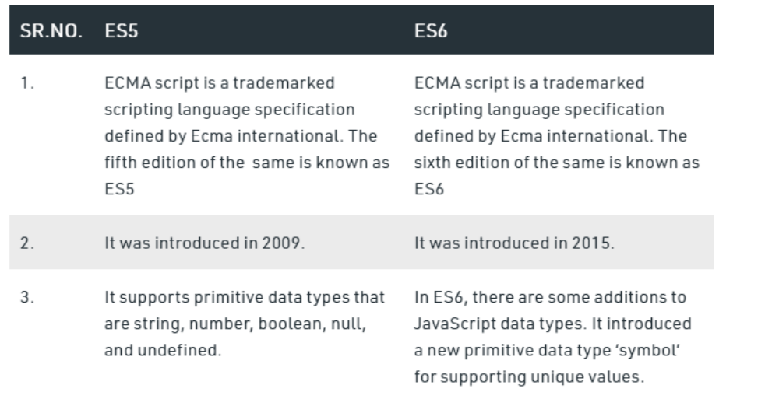
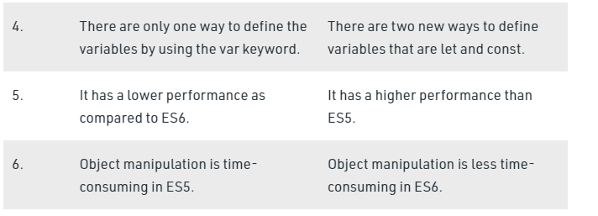

Slide 18
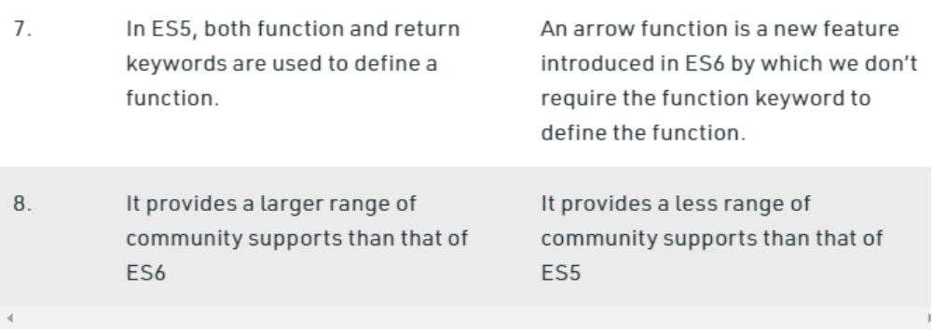

Slide 19
Common uses of JavaScript
    Alert messages
    Popup windows
    Form validation
    Displaying date/time
Notes:
On the client side, JavaScript is loaded into the browser and can run as soon as it is called. Without running on the client side, the page would need to refresh each time you needed a script to run.

Slide 20
What do I need to create JavaScript?
You can create JavaScript using the same softwares you use when creating HTML.
Text editor.
Web Browser.

Slide 21
JavaScript Syntax:
A JavaScript consists of JavaScript statements that are placed within the <script>... </script> HTML tags in a web page.
You can place the <script> tag containing your JavaScript anywhere within you web page but it is preferred way to keep it within the <head> tags.
The <script> tag alert the browser program to begin interpreting all the text between these tags as a script. So simple syntax of your JavaScript will be as follows

Slide 22
<script ...>
JavaScript code
</script>
The script tag takes two important attributes:
language: This attribute specifies what scripting language you are using. Typically, its value will be javascript.
type: This attribute is what is now recommended to indicate the scripting language in use and its value should be set to "text/javascript".
<script language="javascript" type="text/javascript">
JavaScript code
</script>

Slide 23
Java Script Program
<html>
<body>
<script language="javascript" type="text/javascript">
<!--
document.write("Hello World!")
//-->
</script>
</body>
</html>

Slide 24
SCRIPT tags
JavaScript code can be embedded in a Web page using SCRIPT tags
<html>
<body>
<h1>My First Web Page</h1>
<script type="text/javascript">
document.write("<p>" + Date() + "</p>");
</script>
</body>
</html>
OUTPUT
My First Web Page
Sat Oct 01 2011 13:55:53 GMT+0530
(India Standard Time)

Slide 25
JavaScript Placement in HTML File
There is a flexibility given to include JavaScript code anywhere in an HTML document. But there are following most preferred ways to include JavaScript in your HTML file.
Script in <head>...</head> section.
Script in <body>...</body> section.
Script in <body>...</body> and <head>...</head> sections.
Script in and external file and then include in <head>...</head> section.
In the following section we will see how we can put JavaScript in different ways:

Slide 26
JavaScript in <head>...</head> section:
If you want to have a script run on some event, such as when a user clicks somewhere, then you will place that script in the head as follows:
Example Output
JavaScript in <body>...</body> section:
If you need a script to run as the page loads so that the script generates content in the page, the script goes in the <body> portion of the document. In this case you would not have any function defined using JavaScript:
Example output

Slide 27
JavaScript in <body> and <head> sections:
You can put your JavaScript code in <head> and <body> section altogether as follows:
Example output
JavaScript in External File :
As you begin to work more extensively with JavaScript, you will likely find that there are cases where you are reusing identical JavaScript code on multiple pages of a site.
You are not restricted to be maintaining identical code in multiple HTML files. The script tag provides a mechanism to allow you to store JavaScript in an external file and then include it into your HTML files.
Here is an example to show how you can include an external JavaScript file in your HTML code using script tag and its src attribute:
Example output external.js

Slide 28
Scripts in <head> and <body>
JavaScript can be embedded in the <head>, <body>, or in both.
common practice to put all functions in the head section.
Function calls in body section

Slide 29
Using java script
Embedded :
Java script can be written in same .html file using script tag.
    Js1.html → output
<html>
<body>
<script type="text/javascript">
document.write("Hello World!");
</script>
</body>
</html>

Slide 30
External :
Linking to an external JavaScript file
Java script is in a file .js get call in a file .html inside script tag
external.html → OUTPUT
xxx.txt

Slide 31
<html>
<head>
</head>
<body>
<script type="text/javascript" src="xxx.js">
</script>
<p>
The actual script is in an external script file called "xxx.js" this is in ex.html.
</p>
</body>
</html>
document.write
("This is External JavaScript file.");
xxx.js
External.html

Slide 32
<!DOCTYPE html>
<html><head>
<script>
function myFunction() {
document.getElementById("demo").innerHTML = "Paragraph changed.";
}
</script>
</head>
<body>
<h1>A Web Page</h1>
<p id="demo">A Paragraph</p>
<button onclick="myFunction()">Try it</button>
</body>
</html>
_x000b_example

Slide 33
JavaScript ignores spaces, tabs, and newlines that appear in JavaScript programs.
Semicolons are Optional
JavaScript, however, allows you to omit this semicolon if your statements are each placed on a separate line.
For example, the following code could be written without semicolons But when formatted in a single line as follows, the semicolons are required:
<script language="javascript" type="text/javascript">
<!--
var1 = 10
var2 = 20
//-->
</script>
<script language="javascript" type="text/javascript">
<!--
var1 = 10; var2 = 20;
//-->
</script>

Slide 34
JavaScript Identifiers
All JavaScript variables must be identified with unique names.
These unique names are called identifiers.
Identifiers can be short names (like x and y) or more descriptive names (age, sum, totalVolume).
The general rules for constructing names for variables (unique identifiers) are:
Names can contain letters, digits, underscores, and dollar signs.
Names must begin with a letter
Names can also begin with $ and _ (but we will not use it in this tutorial)
Names are case sensitive (y and Y are different variables)
Reserved words (like JavaScript keywords) cannot be used as names

Slide 35
JavaScript is a case-sensitive language.
This means that language keywords, variables, function names, and any other identifiers must always be typed with a consistent capitalization of letters.
Java Script types are dynamic type.
JavaScript Data Types:
JavaScript allows you to work with following primitive data types:
  Numbers eg. 123, 120.50 etc.
  BigInt
  Strings of text e.g. "This text string" etc.
  Boolean e.g. true or false.
  Null
  Undefined
  Symbol
  Non primitive: object,Array

Slide 36
Data Types:
Data types describe the different types or kinds of data that we're going to be working with and storing in variables.
Primitive data types:
In Java script, there are five basic, or primitive, types of data. The five most basic types of data are strings, numbers, booleans, undefined, and null.
Derived Data Types:
Objects and Arrays
JavaScript Types are Dynamic
JavaScript has dynamic types. This means that the same variable can be used to hold different data types:
JavaScript variables can hold different data types: numbers, strings, objects and more:
let length = 16; // Number
let lastName = "Johnson"; // String
let x = {firstName:"John", lastName:"Doe"}; // Object

Slide 37
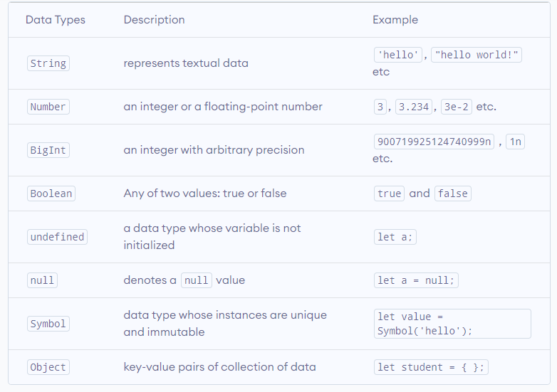

Slide 38
All data types except Object are primitive data types, whereas Object is non-primitive.
The Object data type (non-primitive type) can store collections of data, whereas primitive data type can only store a single data.

Slide 39
String is used to store text. In JavaScript, strings are surrounded by quotes:
Single quotes: 'Hello'
Double quotes: "Hello"
Backticks: `Hello`
For example,
//strings example
const name = 'ram';
const name1 = "hari";
const result = `The names are ${name} and ${name1}`;
Single quotes and double quotes are practically the same and you can use either of them.
Backticks are generally used when you need to include variables or expressions into a string.
This is done by wrapping variables or expressions with ${variable or expression} as shown above.

Slide 40
JavaScript Number
Number represents integer and floating numbers (decimals and exponentials). For example,
const number1 = 3;
const number2 = 3.433;
const number3 = 3e5 // 3 * 10^5
A number type can also be +Infinity, -Infinity, and NaN (not a number). For example,
const number1 = 3/0;
console.log(number1); // Infinity
const number2 = -3/0;
console.log(number2); // -Infinity
// strings can't be divided by numbers
const number3 = "abc"/3;
console.log(number3); // NaN

Slide 41
JavaScript BigInt
In JavaScript, Number type can only represent numbers less than (2^53 - 1) and more than -(2^53 - 1).
However, if you need to use a larger number than that, you can use the BigInt data type.
A BigInt number is created by appending n to the end of an integer.
For example,
// BigInt value
const value1 = 900719925124740998n;
// Adding two big integers
const result1 = value1 + 1n;
console.log(result1); // "900719925124740999n"
const value2 = 900719925124740998n;
// Error! BitInt and number cannot be added
const result2 = value2 + 1;
console.log(result2);

Slide 42
JavaScript Boolean
This data type represents logical entities.
Boolean represents one of two values: true or false.
It is easier to think of it as a yes/no switch.
For example,
const dataChecked = true;
const valueCounted = false;

Slide 43
JavaScript undefined
The undefined data type represents value that is not assigned.
If a variable is declared but the value is not assigned, then the value of that variable will be undefined.
For example,
let name;
console.log(name); // undefined
It is also possible to explicitly assign a variable value undefined. For example,
let name = undefined;
console.log(name); // undefined
It is recommended not to explicitly assign undefined to a variable.
Usually, null is used to assign 'unknown' or 'empty' value to a variable.

Slide 44
Undefined
In JavaScript, a variable without a value, has the value undefined.
The type is also undefined.
Example
let car; // Value is undefined, type is undefined
Any variable can be emptied, by setting the value to undefined. The type will also be undefined.
Example
car = undefined; // Value is undefined, type is undefined

Slide 45
JavaScript null
In JavaScript, null is a special value that represents empty or unknown value. For example,
const number = null;
The code above suggests that the number variable is empty.
Note: null is not the same as NULL or Null.
JavaScript Symbol
This data type was introduced in a newer version of JavaScript (from ES2015).
A value having the data type Symbol can be referred to as a symbol value. Symbol is an immutable primitive value that is unique. For example,
// two symbols with the same description
const value1 = Symbol('hello');
const value2 = Symbol('hello');

Slide 46
JavaScript Symbol
The JavaScript ES6 introduced a new primitive data type called Symbol. Symbols are immutable (cannot be changed) and are unique. For example,
// two symbols with the same description
const value1 = Symbol('hello');
const value2 = Symbol('hello');
console.log(value1 === value2); // false
Though value1 and value2 both contain the same description, they are different.

Slide 47
Creating Symbol
You use the Symbol() function to create a Symbol. For example,
// creating symbol
const x = Symbol()
typeof x; // symbol
You can pass an optional string as its description. For example,
const x = Symbol('hey');
console.log(x); // Symbol(hey)

Slide 48
Access Symbol Description
To access the description of a symbol, we use the . operator. For example,
const x = Symbol('hey');
console.log(x.description); // hey

Slide 49
Add Symbol as an Object Key
You can add symbols as a key in an object using square brackets []. For example,
let id = Symbol("id");
let person = {
name: "Jack",
// adding symbol as a key
[id]: 123 // not "id": 123
};
console.log(person); // {name: "Jack", Symbol(id): 123}

Slide 50
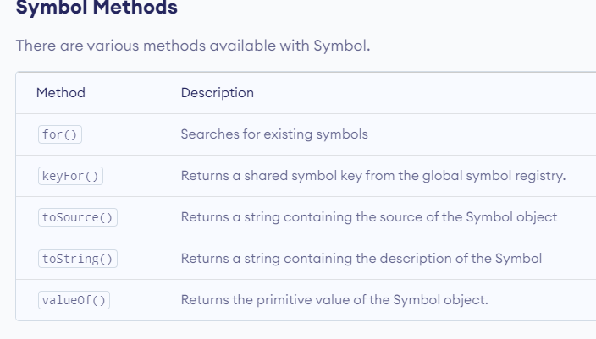

Slide 51
Example: Symbol Methods
// get symbol by name
let sym = Symbol.for('hello');
let sym1 = Symbol.for('id');
// get name by symbol
console.log( Symbol.keyFor(sym) ); // hello
console.log( Symbol.keyFor(sym1) ); // id

Slide 52
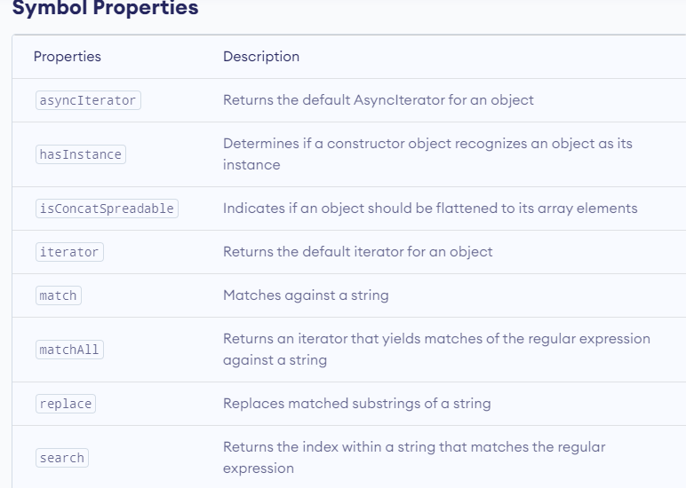
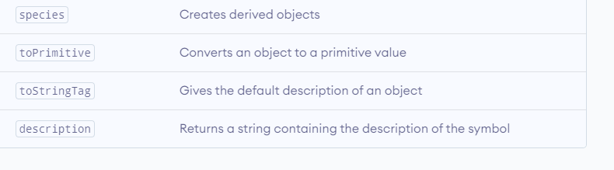

Slide 53
Example: Symbol Properties Example
const x = Symbol('hey');
// description property
console.log(x.description); // hey
const stringArray = ['a', 'b', 'c'];
const numberArray = [1, 2, 3];
// isConcatSpreadable property
numberArray[Symbol.isConcatSpreadable] = false;
let result = stringArray.concat(numberArray);
console.log(result); // ["a", "b", "c", [1, 2, 3]]

Slide 54
JavaScript Objects
JavaScript objects are written with curly braces {}.
Object properties are written as name:value pairs, separated by commas.
Example
const person = {firstName:"John", lastName:"Doe", age:50, eyeColor:"blue"};
The object (person) in the example above has 4 properties: firstName, lastName, age, and eyeColor.

Slide 55
JavaScript Object
An object is a complex data type that allows us to store collections of data. For example,
const student = {
firstName: 'ram',
lastName: null,
class: 10
};

Slide 56
JavaScript Object Declaration
The syntax to declare an object is:
const object_name = {
key1: value1,
key2: value2
}
Here, an object object_name is defined. Each member of an object is a key: value pair separated by commas and enclosed in curly braces {}.
For example,
// object creation
const person = {
name: 'John',
age: 20
};
console.log(typeof person); // object

Slide 57
JavaScript Object Properties
In JavaScript, "key: value" pairs are called properties. For example,
let person = {
name: 'John',
age: 20
};
Here, name: 'John' and age: 20 are properties.

Slide 58
Accessing Object Properties
You can access the value of a property by using its key.
1. Using dot Notation
Here's the syntax of the dot notation.
objectName.key
For example,
const person = {
name: 'John',
age: 20,
};
// accessing property
console.log(person.name); // John

Slide 59
2. Using bracket Notation
Here is the syntax of the bracket notation.
objectName["propertyName"]
For example,
const person = {
name: 'John',
age: 20,
};
// accessing property
console.log(person["name"]); // John

Slide 60
JavaScript Nested Objects
An object can also contain another object. For example,
// nested object
const student = {
name: 'John',
age: 20,
marks: {
science: 70,
math: 75
}
}
// accessing property of student object
console.log(student.marks); // {science: 70, math: 75}
// accessing property of marks object
console.log(student.marks.science); // 70

Slide 61
JavaScript Object Methods
In JavaScript, an object can also contain a function. For example,
const person = {
name: 'Sam',
age: 30,
// using function as a value
greet: function() { console.log('hello') }
}
person.greet(); // hello

Slide 62
JavaScript Arrays
JavaScript arrays are written with square brackets.
Array items are separated by commas.
The following code declares (creates) an array called cars, containing three items (car names):
Example
const cars = ["Saab", "Volvo", "BMW"];
Array indexes are zero-based, which means the first item is [0], second is [1], and so on.

Slide 63
JavaScript Type
JavaScript is a dynamically typed (loosely typed) language. JavaScript automatically determines the variables' data type for you.
It also means that a variable can be of one data type and later it can be changed to another data type. For example,
// data is of undefined type
let data;
// data is of integer type
data = 5;
// data is of string type
data = "JavaScript Programming";

Slide 64
JavaScript typeof:
To find the type of a variable, you can use the typeof operator. For example,
const name = 'ram';
typeof(name); // returns "string"
const number = 4;
typeof(number); //returns "number"
const valueChecked = true;
typeof(valueChecked); //returns "boolean"
const a = null;
typeof(a); // returns "object"

Slide 65
console.log("hello")
let a=10
console.log("a="+a)
console.log(typeof(a))
var b=20

Slide 66
Data types
A value in JavaScript is always of a certain type. For example, a string or a number.
There are eight basic data types in JavaScript. Here, we’ll cover them in general and in the next chapters we’ll talk about each of them in detail.
We can put any type in a variable.
For example, a variable can at one moment be a string and then store a number:
// no error
let message = "hello";
message = 123456;
Programming languages that allow such things, such as JavaScript, are called “dynamically typed”, meaning that there exist data types, but variables are not bound to any of them.

Slide 67
Number:
let n = 123;
n = 12.345;
The number type represents both integer and floating point numbers.
There are many operations for numbers, e.g. multiplication *, division /, addition +, subtraction -, and so on.
Besides regular numbers, there are so-called “special numeric values” which also belong to this data type: Infinity, -Infinity and NaN.
Infinity represents the mathematical Infinity ∞. It is a special value that’s greater than any number.
We can get it as a result of division by zero:
alert( 1 / 0 ); // Infinity

Slide 68
alert( 1 / 0 ); // Infinity
alert( Infinity ); // Infinity
NaN represents a computational error. It is a result of an incorrect or an undefined mathematical operation, for instance:
alert( "not a number" / 2 ); // NaN, such division is erroneous
NaN is sticky. Any further mathematical operation on NaN returns NaN:
alert( NaN + 1 ); // NaN
alert( 3 * NaN ); // NaN
alert( "not a number" / 2 - 1 ); // NaN
So, if there’s a NaN somewhere in a mathematical expression, it propagates to the whole result (there’s only one exception to that: NaN ** 0 is 1).

Slide 69
In JavaScript, the “number” type cannot safely represent integer values larger than (2^53-1) (that’s 9007199254740991), or less than -(2^53-1) for negatives.
To be really precise, the “number” type can store larger integers (up to 1.7976931348623157 * 10308), but outside of the safe integer range ±(253-1) there’ll be a precision error, because not all digits fit into the fixed 64-bit storage.
So an “approximate” value may be stored.
For example, these two numbers (right above the safe range) are the same:
console.log(9007199254740991 + 1); // 9007199254740992
console.log(9007199254740991 + 2); // 9007199254740992

Slide 70
A string in JavaScript must be surrounded by quotes.
let str = "Hello";
let str2 = 'Single quotes are ok too';
let phrase = `can embed another ${str}`;
In JavaScript, there are 3 types of quotes.
Double quotes: "Hello".
Single quotes: 'Hello'.
Backticks: `Hello`.

Slide 71
Double and single quotes are “simple” quotes.
There’s practically no difference between them in JavaScript.
Backticks are “extended functionality” quotes.
They allow us to embed variables and expressions into a string by wrapping them in ${…}, for example:
let name = "John";
// embed a variable
alert( `Hello, ${name}!` ); // Hello, John!
// embed an expression
alert( `the result is ${1 + 2}` ); // the result is 3
The expression inside ${…} is evaluated and the result becomes a part of the string.
We can put anything in there: a variable like name or an arithmetical expression like 1 + 2 or something more complex.

Slide 72
The expression inside ${…} is evaluated and the result becomes a part of the string. We can put anything in there: a variable like name or an arithmetical expression like 1 + 2 or something more complex.
Please note that this can only be done in backticks. Other quotes don’t have this embedding functionality!
alert( "the result is ${1 + 2}" ); // the result is ${1 + 2} (double quotes do nothing)

Slide 73
The boolean type has only two values: true and false.
This type is commonly used to store yes/no values: true means “yes, correct”, and false means “no, incorrect”.
For instance:
let nameFieldChecked = true; // yes, name field is checked
let ageFieldChecked = false; // no, age field is not checked
Boolean values also come as a result of comparisons:
let isGreater = 4 > 1;
alert( isGreater ); // true (the comparison result is "yes")
We’ll cover booleans more deeply in the chapter Logical operators.

Slide 74
The special null value does not belong to any of the types described above.
It forms a separate type of its own which contains only the null value:
let age = null;
In JavaScript, null is not a “reference to a non-existing object” or a “null pointer” like in some other languages.
It’s just a special value which represents “nothing”, “empty” or “value unknown”.
The code above states that age is unknown.

Slide 75
The special value undefined also stands apart. It makes a type of its own, just like null.
The meaning of undefined is “value is not assigned”.
If a variable is declared, but not assigned, then its value is undefined:
let age;
alert(age); // shows "undefined"
Technically, it is possible to explicitly assign undefined to a variable:
let age = 100;
// change the value to undefined
age = undefined;
alert(age); // "undefined"

Slide 76
A call to typeof x returns a string with the type name:
typeof undefined // "undefined"
typeof 0 // "number"
typeof 10n // "bigint"
typeof true // "boolean"
typeof "foo" // "string"
typeof Symbol("id") // "symbol"
typeof Math // "object" (1)
typeof null // "object" (2)
typeof alert // "function" (3)

Slide 77
Summary
There are 8 basic data types in JavaScript.
Seven primitive data types:
number for numbers of any kind: integer or floating-point, integers are limited by ±(253-1).
bigint for integer numbers of arbitrary length.
string for strings. A string may have zero or more characters, there’s no separate single-character type.
boolean for true/false.
null for unknown values – a standalone type that has a single value null.
undefined for unassigned values – a standalone type that has a single value undefined.
symbol for unique identifiers.
And one non-primitive data type:
object for more complex data structures.

Slide 78
Arrays
Objects allow you to store keyed collections of values.
But quite often we find that we need an ordered collection, where we have a 1st, a 2nd, a 3rd element and so on.
For example, we need that to store a list of something: users, goods, HTML elements etc.
It is not convenient to use an object here, because it provides no methods to manage the order of elements.
We can’t insert a new property “between” the existing ones. Objects are just not meant for such use.
There exists a special data structure named Array, to store ordered collections.

Slide 79
Declaration
There are two syntaxes for creating an empty array:
let arr = new Array();
let arr = [];
Almost all the time, the second syntax is used. We can supply initial elements in the brackets:
let fruits = ["Apple", "Orange", "Plum"];
Array elements are numbered, starting with zero.
We can get an element by its number in square brackets:
let fruits = ["Apple", "Orange", "Plum"];

Slide 80
alert( fruits[0] ); // Apple
alert( fruits[1] ); // Orange
alert( fruits[2] ); // Plum
We can replace an element:
fruits[2] = 'Pear'; // now ["Apple", "Orange", "Pear"]
…Or add a new one to the array:
fruits[3] = 'Lemon'; // now ["Apple", "Orange", "Pear", "Lemon"]

Slide 81
The total count of the elements in the array is its length:
let fruits = ["Apple", "Orange", "Plum"];
alert( fruits.length ); // 3
We can also use alert to show the whole array.
let fruits = ["Apple", "Orange", "Plum"];
alert( fruits ); // Apple,Orange,Plum
An array can store elements of any type.
For instance:
// mix of values
let arr = [ 'Apple', { name: 'John' }, true, function() { alert('hello'); } ];
// get the object at index 1 and then show its name
alert( arr[1].name ); // John
// get the function at index 3 and run it
arr[3](); // hello

Slide 82
let fruits = ["Apple", "Orange", "Plum"];
alert( fruits[fruits.length-1] ); // Plum
fruits[-1].
fruits.at(-1):
let fruits = ["Apple", "Orange", "Plum"];
// same as fruits[fruits.length-1]
alert( fruits.at(-1) ); // Plum

Slide 83
Methods pop/push, shift/unshift
A queue is one of the most common uses of an array.
Ordered collection of elements which supports two operations:
push appends an element to the end.
shift get an element from the beginning, advancing the queue, so that the 2nd element becomes the 1st.

Slide 84
Arrays support both operations.
In practice we need it very often. For example, a queue of messages that need to be shown on-screen.
There’s another use case for arrays – the data structure named stack.
It supports two operations:
push adds an element to the end.
pop takes an element from the end.
So new elements are added or taken always from the “end”.
A stack is usually illustrated as a pack of cards: new cards are added to the top or taken from the top:
For stacks, the latest pushed item is received first, that’s also called LIFO (Last-In-First-Out) principle. For queues, we have FIFO (First-In-First-Out).
Arrays in JavaScript can work both as a queue and as a stack. They allow you to add/remove elements, both to/from the beginning or the end.

Slide 85
Methods that work with the end of the array:
pop
Extracts the last element of the array and returns it:
let fruits = ["Apple", "Orange", "Pear"];
alert( fruits.pop() ); // remove "Pear" and alert it
alert( fruits ); // Apple, Orange
Both fruits.pop() and fruits.at(-1) return the last element of the array, but fruits.pop() also modifies the array by removing it.

Slide 86
push
Append the element to the end of the array:
let fruits = ["Apple", "Orange"];
fruits.push("Pear");
alert( fruits ); // Apple, Orange, Pear
The call fruits.push(...) is equal to fruits[fruits.length] = ....

Slide 87
Methods that work with the beginning of the array:
Shift:
Extracts the first element of the array and returns it:
let fruits = ["Apple", "Orange", "Pear"];
alert( fruits.shift() ); // remove Apple and alert it
alert( fruits ); // Orange, Pear
Unshift:
Add the element to the beginning of the array:
let fruits = ["Orange", "Pear"];
fruits.unshift('Apple');
alert( fruits ); // Apple, Orange, Pear
Methods push and unshift can add multiple elements at once:

Slide 88
JavaScript Variables
Local JavaScript Variables
A variable declared within a JavaScript function becomes LOCAL and can only be accessed within that function. (the variable has local scope).
Local variables are destroyed when you exit the function.
Global JavaScript Variables
Variables declared outside a function become GLOBAL, and all scripts and functions on the web page can access it.
Global variables are destroyed when you close the page.

Slide 89
Rules for JavaScript Variables
Can contain any letter of the alphabet, digits 0-9, and the underscore character.
No spaces
No punctuation characters (eg comma, full stop, etc)
The first character of a variable name cannot be a digit.
JavaScript variables' names are case-sensitive. For example firstName and FirstName are two different variables.

Slide 90
Variables are containers for storing data (values).
There are 3 ways to declare a JavaScript variable:
Using var
Using let
Using const

Slide 91
JavaScript Variables
In a programming language, variables are used to store data values.
JavaScript uses the keywords var, let and const to declare variables.
An equal sign is used to assign values to variables.
In this example, x is defined as a variable. Then, x is assigned (given) the value 6:
let x;
x = 6;

Slide 92
Different methods of declaring JavaScript variables
// declaring one javascript variable
var firstName;
// declaring multiple javascript variables
var firstName, lastName;
// declaring and assigning one javascript variable
var firstName = 'Homer';
// declaring and assigning multiple javascript variables
var firstName = ‘VESIT’, lastName = ‘ CHEMBUR’;

Slide 93
Let :
The let keyword was introduced in ES6 (2015).
Variables defined with let cannot be Redeclared.
Variables defined with let must be Declared before use.
Variables defined with let have Block Scope.
With let you can not do this:
Example
let x = "John Doe";
let x = 0;
// SyntaxError: 'x' has already been declared

Slide 94
Block Scope
Before ES6 (2015), JavaScript had only Global Scope and Function Scope.
ES6 introduced two important new JavaScript keywords: let and const.
These two keywords provide Block Scope in JavaScript.
Variables declared inside a { } block cannot be accessed from outside the block:

Slide 95
{
let x = 2;
}
// x can NOT be used here
{
var x = 2;
}
// x can be used here
example

Slide 96
let x = 10;
// Here x is 10
{
let x = 2;
// Here x is 2
}
// Here x is 10

Slide 97
CONST:
The const keyword was introduced in ES6 (2015).
Variables defined with const cannot be Redeclared.
Variables defined with const cannot be Reassigned.
Variables defined with const have Block Scope.
A const variable cannot be reassigned:
const PI = 3.141592653589793;
PI = 3.14; // This will give an error
PI = PI + 10; // This will also give an error
JavaScript const variables must be assigned a value when they are declared:

Slide 98
Block Scope
Declaring a variable with const is similar to let when it comes to Block Scope.
The x declared in the block, in this example, is not the same as the x declared outside the block:
Example
const x = 10;
// Here x is 10
{
const x = 2;
// Here x is 2
}
// Here x is 10

Slide 99
JavaScript Comments
Single line : //
Multiline comment: /* */
<html>
<body>
<script type="text/javascript">
// Write a heading
document.write("<h1>This is a heading</h1>");
// Write paragraph
document.write("<p>This is a paragraph.</p>");
</script>
</body>
</html>

Slide 100
JavaScript Output
JavaScript Display Possibilities
JavaScript can "display" data in different ways:
Writing into an HTML element, using innerHTML.
Writing into the HTML output using document.write().
Writing into an alert box, using window.alert().
Writing into the browser console, using console.log().

Slide 101
Using innerHTML
To access an HTML element, JavaScript can use the document.getElementById(id) method.
The id attribute defines the HTML element. The innerHTML property defines the HTML content:
Example
<!DOCTYPE html>
<html>
<body>
<h1>My First Web Page</h1>
<p>My First Paragraph</p>
<p id="demo"></p>
<script>
document.getElementById("demo").innerHTML = 5 + 6;
</script>
</body>
</html>

Slide 102
Using document.write()
For testing purposes, it is convenient to use document.write():
Example
<!DOCTYPE html>
<html>
<body>
<h1>My First Web Page</h1>
<p>My first paragraph.</p>
<script>
document.write(5 + 6);
</script>
</body>
</html>

Slide 103
<!DOCTYPE html>
<html>
<body>
<h1>My First Web Page</h1>
<p>My first paragraph.</p>
<button onclick="document.write(5 + 6)">Try it</button>
</body>
</html>
example

Slide 104
Using window.alert()
You can use an alert box to display data:
Example
<!DOCTYPE html>
<html>
<body>
<h1>My First Web Page</h1>
<p>My first paragraph.</p>
<script>
window.alert(5 + 6);
</script>
</body>
</html>
alert

Slide 105
Using console.log()
For debugging purposes, you can call the console.log() method in the browser to display data.
Example
<!DOCTYPE html>
<html>
<body>
<script>
console.log(5 + 6);
</script>
</body>
</html>

Slide 106
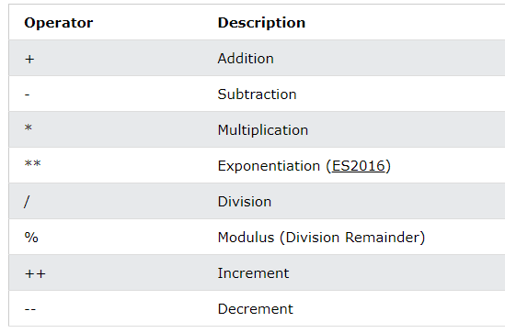
Operators:
JavaScript Arithmetic Operators
Arithmetic operators are used to perform arithmetic on numbers:

Slide 107
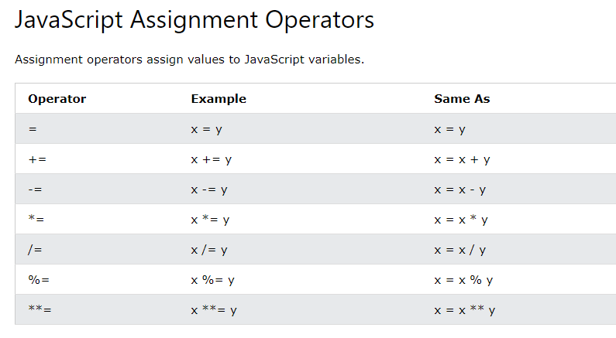

Slide 108
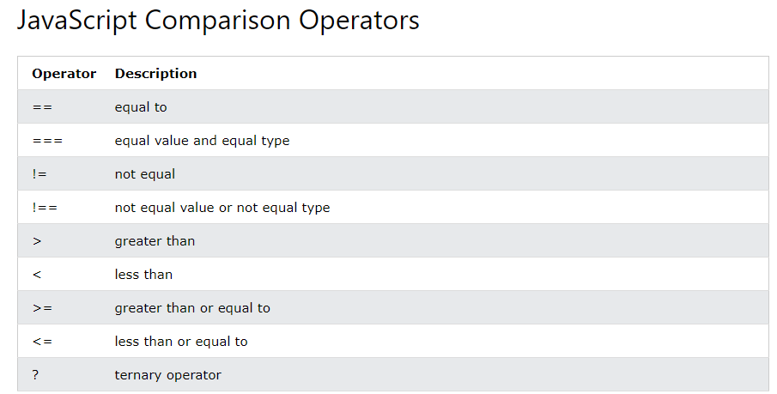

Slide 109
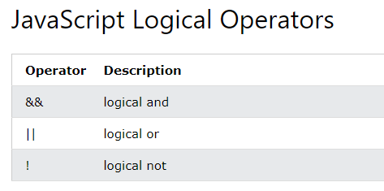

Slide 110
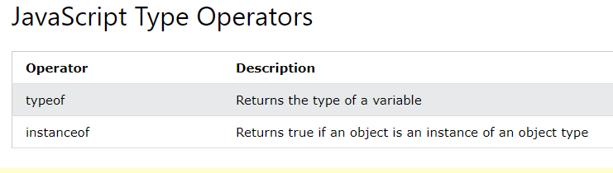

Slide 111
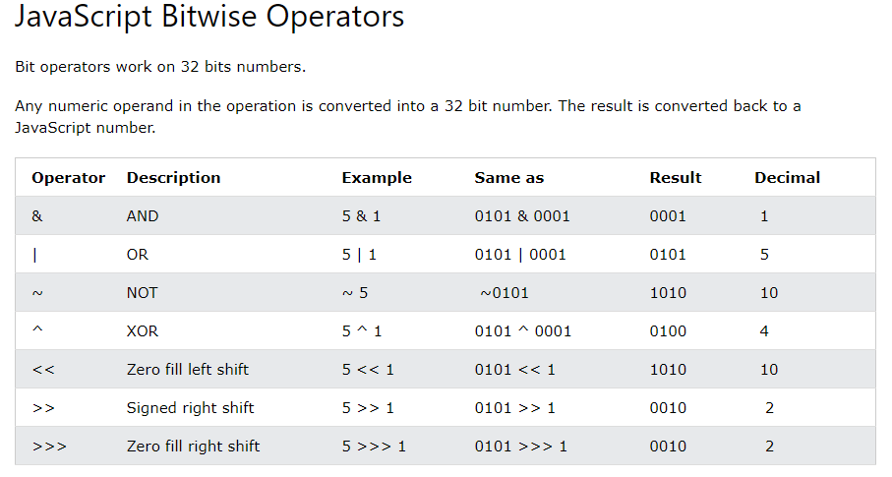

Slide 112
JavaScript Assignment Operators
X=10 and y=5
Operator | Example | Same As | Result
= | x=y |  | x=5
+= | x+=y | x=x+y | x=15
-= | x-=y | x=x-y | x=5
*= | x*=y | x=x*y | x=50
/= | x/=y | x=x/y | x=2
%= | x%=y | x=x%y | x=0

Slide 113
JavaScript Logical Operators
Given that x=6 and y=3, the table below explains the logical operators:
Operator | Description | Example
&& | and | (x < 10 && y > 1) is true
|| | or | (x==5 || y==5) is false
! | not | !(x==y) is true

Slide 114
JavaScript Comparison Operators
Given that x=5
Operator | Description | Example
= = | is equal to | x= =8 is false x= =5 is true
= = = (strict comparision) | is exactly equal to (value and type) | x= = =5 is true x= = ="5" is false Example output
!= | is not equal | x!=8 is true
> | is greater than | x>8 is false
< | is less than | x<8 is true
>= | is greater than or equal to | x>=8 is false
<= | is less than or equal to | x<=8 is true

Slide 115
Conditional Operator
variablename=(condition)?value1:value2

Slide 116
Escape sequence
Code | Outputs
\' | single quote
\" | double quote
\\ | backslash
\n | new line
\r | carriage return
\t | tab
\b | backspace
Example: esc.html → output

Slide 117
Why use == in JavaScript?
Here are the important uses of == in JavaScript:
The == operator is an equality operator.
It checks whether its two operands are the same or not by changing expression from one data type to others.
You can use == operator in order to compare the identity of two operands even though, they are not of a similar type.
How === Works Exactly?
Strict equality === checks that two values are the same or not.
Value are not implicitly converted to some other value before comparison.
If the variable values are of different types, then the values are considered as unequal.
If the variable are of the same type, are not numeric, and have the same value, they are considered as equal.
Lastly, If both variable values are numbers, they are considered equal if both are not NaN (Not a Number) and are the same value.

Slide 118
<!DOCTYPE html>
<html>
<body>
<h2>JavaScript Operators</h2>
<p>a = 2, b = 5, calculate c = a + b, and display c:</p>
<p id="demonstration"></p>
<script>
var a = 2;
var b = 5;
var c= a + b;
document.getElementById("demonstration").innerHTML = c;
</script>
</body>
</html>

Slide 119
<!DOCTYPE html>
<html>
<body>
<p id="demonstration"></p>
<script>
var a = 10;
document.getElementById("demonstration").innerHTML = (a == 20);
</script>
</body>
</html>

Slide 120
<!DOCTYPE html>
<html>
<body>
<p id="demo"></p>
<script>
var x = 10;
document.getElementById("demo").innerHTML = (x === "10");
</script>
</body>
</html>

Slide 121
JavaScript Popup Boxes
JavaScript has three kind of popup boxes:
Alert box
Confirm box
Prompt box.

Slide 122
Alert Box
An alert box is often used if you want to make sure information comes through to the user.
When an alert box pops up, the user will have to click "OK" to proceed.
Syntax
alert("sometext");
Example: alert.html → output

Slide 123
Confirm Box
A confirm box is often used if you want the user to verify or accept something.
When a confirm box pops up, the user will have to click either "OK" or "Cancel" to proceed.
If the user clicks "OK", the box returns true. If the user clicks "Cancel", the box returns false.
Syntax
confirm("sometext");
Example: confirm.html → output

Slide 124
Prompt Box
A prompt box is often used if you want the user to input a value before entering a page.
When a prompt box pops up, the user will have to click either "OK" or "Cancel" to proceed after entering an input value.
If the user clicks "OK" the box returns the input value. If the user clicks "Cancel" the box returns null.
Syntax
prompt("sometext","defaultvalue");
Example: prompt.html → output
Factorial output

Slide 125
Control Statements:
Sequential
Conditional
  If
  If-else
  Switch
Iterative
  For
  While
  Do while

Slide 126

Conditional Statements
if statement
if...else statement
if...else if....else statement
switch statement

Slide 127
If statement
if (condition)
{
code to be executed if condition is true
}
if.html → output

Slide 128
If...else Statement
if (condition)
{
code to be executed if condition is true
}
else
{
code to be executed if condition is not true
}
If_else.html → output

Slide 129
If...else if...else Statement
if (condition1)
{
code to be executed if condition1 is true
}
else if (condition2)
{
code to be executed if condition2 is true
}
else
{
code to be executed if neither condition1 nor condition2 is true
}
If_else_if_else.html → output

Slide 130
The JavaScript Switch Statement
switch(n)
{
case 1:
execute code block 1
break;
case 2:
execute code block 2
break;
default:
code to be executed if n is different from case 1 and 2
}
Switch.html → output
Switch1.html → output

Slide 131
For loop
for (var=start ; var<=end ; var=var+incr)
{
code to be executed
}
For.html → output

Slide 132
The while Loop
<html>
<body>
<script type="text/javascript">
var i=0;
while (i<=5)
{
document.write("The number is " + i);
document.write("<br />");
i++;
}
</script>
</body>
</html>

Slide 133
The do...while Loop
<html>
<body>
<script type="text/javascript">
var i=0;
do
{
document.write("The number is " + i);
document.write("<br />");
i++;
}
while (i<=5);
</script>
</body>
</html>

Slide 134
The break Statement
The break statement will break the loop and continue executing the code that follows after the loop (if any).
<html>
<body>
<script type="text/javascript">
var i=0;
for (i=0;i<=10;i++)
{
if (i==3)
{
break;
}
document.write("The number is " + i);
document.write("<br />");
}
document.write("The loop break ");
</script>
</body>
</html>

Slide 135
The continue Statement
<html>
<body>
<script type="text/javascript">
var i=0
for (i=0;i<=10;i++)
{
if (i= =3)
{
continue;
}
document.write("The number is " + i);
document.write("<br />");
}
</script>
</body>
</html>

Slide 136
For...In Statement
The for...in statement loops through the properties of an object.
<html>
<body>
<script type="text/javascript">
var person={fname:“VESIT”, lname:“Chembur”};
for (x in person)
{
document.write(person[x] + " ");
}
</script>
</body>
</html>

Slide 137
Functions
Function Definition:
Before we use a function we need to define that function. The most common way to define a function in JavaScript is by using the function keyword, followed by a unique function name, a list of parameters (that might be empty), and a statement block surrounded by curly braces. The basic syntax is shown here:
<script type="text/javascript"> <!-- function functionname(parameter-list) { statements } //--> </script>
Example output

Slide 138
<!DOCTYPE html>
<body>
<script>
function myFunction(a, b) {
return a * b;
}
var ans=myFunction(5,6)
document.write(ans)
</script>
</body>
</html>
Example

Slide 139
//return argument length
function myFunction(a, b) {
return arguments.length;
}
Click on a button to call a function, which will output "Hello World" in an element with id="demo":
<button onclick="myFunction()">Click me</button>
<p id="demo"></p>
<script>
function myFunction() {
document.getElementById("demo").innerHTML = "Hello World";
}
</script>

Slide 140
A JavaScript function can also be defined using an expression.
A function expression can be stored in a variable:
var x = function (a, b) {return a * b};
var x = function (a, b) {return a * b};
var z = x(4, 3);

Slide 141
<!DOCTYPE html>
<body>
<script>
var x = function (a, b) {return a * b};
var z = x(4, 3);
document.write(z)
</script>
</body>
</html>
Example calculator cal_Function

Slide 142
The return Statement:
A JavaScript function can have an optional return statement. This is required if you want to return a value from a function. This statement should be the last statement in a function.
For example you can pass two numbers in a function and then you can expect from the function to return their multiplication in your calling program.
Example Output
calculatorExample output

Slide 143
Functions
We started by using the function keyword. This tells the browser that a function is about to be defined.
function definitions are similar to C++/Java, except:
  no return type for the function (since variables are loosely typed)
  no types for parameters (since variables are loosely typed)
  by-value parameter passing only (parameter gets copy of argument)
Functions.html output

Slide 144
Difference between regular functions and arrow functions
Arrow functions – a new feature introduced in ES6 – enable writing concise functions in JavaScript. While both regular and arrow functions work in a similar manner, yet there are certain interesting differences between them, as discussed below.
Syntax of regular functions:-
let x = function function_name(parameters){
// body of the function
};
let square = function(x){
return (x*x);
};
console.log(square(9));

Slide 145
JavaScript Arrow Function
Arrow function is one of the features introduced in the ES6 version of JavaScript. It allows you to create functions in a cleaner way compared to regular functions.
For example,
// function expression
let x = function(x, y) {
return x * y;
}
can be written as
// using arrow functions
let x = (x, y) => x * y;
Arrow.html

Slide 146
Arrow Function Syntax
The syntax of the arrow function is:
let myFunction = (arg1, arg2, ...argN) => {
statement(s)
}
myFunction is the name of the function
arg1, arg2, ...argN are the function arguments
statement(s) is the function body

Slide 147
If the body has single statement or expression, you can write arrow function as:
let myFunction = (arg1, arg2, ...argN) => expression

Slide 148
Example 1: Arrow Function with No Argument
If a function doesn't take any argument, then you should use empty parentheses. For example,
let greet = () => console.log('Hello');
greet(); // Hello
Example 2: Arrow Function with One Argument
If a function has only one argument, you can omit the parentheses. For example,
let greet = x => console.log(x);
greet('Hello'); // Hello

Slide 149
Example 3: Arrow Function as an Expression
You can also dynamically create a function and use it as an expression. For example,
let age = 5;
let welcome = (age < 18) ?
() => console.log('Baby') :
() => console.log('Adult');
welcome(); // Baby

Slide 150
Example 4: Arrow Function with Multiline statement
If a function body has multiple statements, you need to put them inside curly brackets {}. For example,
let sum = (a, b) => {
let result = a + b;
return result;
}
let result1 = sum(5,7);
console.log(result1); // 12

Slide 151
The syntax of arrow functions:-
let x = (parameters) => {
// body of the function
};
Example of arrow functions:-
var square = (x) => {
return (x*x);
};
console.log(square(9));

Slide 152
// Traditional Function
function (a){
return a + 100;
}
// Arrow Function Break Down
// 1. Remove the word "function" and place arrow between the argument and opening body bracket
(a) => {
return a + 100;
}
// 2. Remove the body braces and word "return" -- the return is implied.
(a) => a + 100;
// 3. Remove the argument parentheses
a => a + 100;

Slide 153
// Traditional Function
function (a, b){
return a + b + 100;
}
// Arrow Function
(a, b) => a + b + 100;
// Traditional Function (no arguments)
let a = 4;
let b = 2;
function (){
return a + b + 100;
}
// Arrow Function (no arguments)
let a = 4;
let b = 2;
() => a + b + 100;

Slide 154
JavaScript HTML DOM - Changing CSS
The HTML DOM allows JavaScript to change the style of HTML elements.
Changing HTML Style
To change the style of an HTML element, use this syntax:
document.getElementById(id).style.property = new style
The following example changes the style of a <p> element:
Example
<html>
<body>
<p id="p2">Hello World!</p>
<script>
document.getElementById("p2").style.color = "blue";
</script>
</body>
</html>

Slide 155
JavaScript Events
JavaScript Events
The change in the state of an object is known as an Event.
In html, there are various events which represents that some activity is performed by the user or by the browser.
When java script code is included in HTML, java script react over these events and allow the execution.
This process of reacting over the events is called Event Handling.
Thus, java script handles the HTML events via Event Handlers.
For example, when a user clicks over the browser, add java script code, which will execute the task to be performed on the event.

Slide 156
Examples of events
A mouse click
A web page or an image loading
Mousing over a spot on the web page
Selecting an input box in an HTML form
Submitting an HTML form

Slide 157
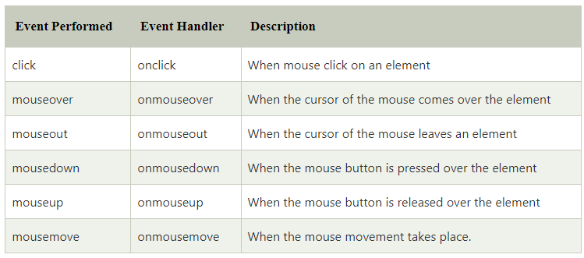
Some of the HTML events and their event handlers are:
Mouse events:
Mouseover

Slide 158
<html>
<head>
<script type = "text/javascript">
<!--
function over() {
document.write ("Mouse Over");
}
function out() {
document.write ("Mouse Out");
}
//-->
</script>
</head>
<body>
<p>Bring your mouse inside the division to see the result:</p>
<div onmouseover = "over()" onmouseout = "out()">
<h2> This is inside the division </h2>
</div>
</body>
</html> example

Slide 159
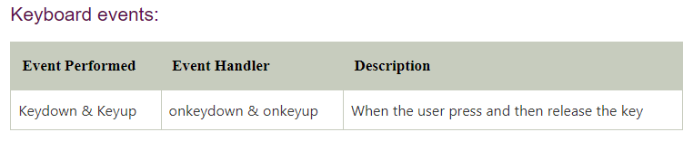
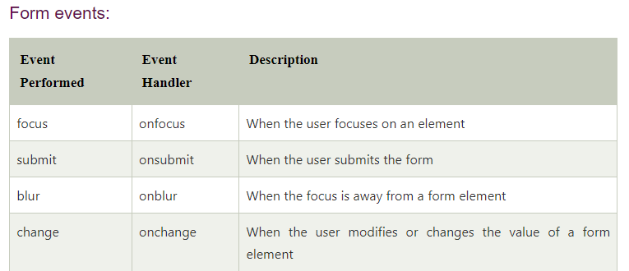
Keyboard Event OnFocusEvent

Slide 160
Keydown.html
<html>
<head> Javascript Events</head>
<body>
<h2> Enter something here</h2>
<input type="text" id="input1" onkeydown="keydownevent()"/>
<script>
<!--
function keydownevent()
{
document.getElementById("input1");
alert("Pressed a key");
}
//-->
</script>
</body>
</html>

Slide 161
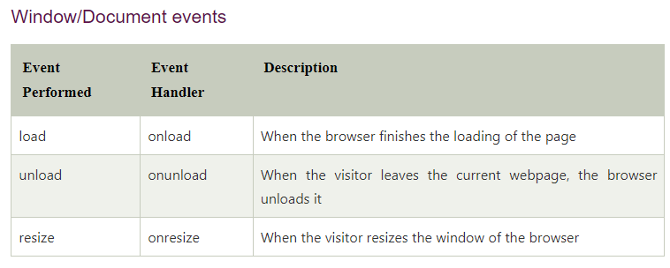

Slide 162
Event handler | Applies to: | triggered when:
onAbort | Image | The loading of the image is cancelled.
onBlur | Button, Checkbox, FileUpload, Layer, password, Radio, Reset, Select, Submit, Text, TextArea, Window | The object in question loses focus (e.g. by clicking outside it or pressing the TAB key).
onChange | FileUpload, Select, Text, TextArea | The data in the form element is changed by the user.
onClick | Button, Document, Checkbox, Link, Radio, Reset, Submit | The object is clicked on.
onDblClick | Document, Link | The object is double-clicked on.
onDragDrop | Window | An icon is dragged and dropped into the browser.
onError | Image, Window | A JavaScript error occurs.

Slide 163
Event handler | Applies to: | triggered when:
onFocus | Button, Checkbox, FileUpload, Layer, Password, Radio, Reset, Select, Submit, Text, TextArea, Window | The object in question gains focus (e.g. by clicking on it or pressing the TAB key).
onKeyDown | Document, Image, Link, TextArea | The user presses a key.
onKeyPress | Document, Image, Link, TextArea | The user presses or holds down a key.
onKeyUp | Document, Image, Link, TextArea | The user releases a key
onLoad | Image, Window | The whole page has finished loading.
onMouseDown | Button, Document, Link | The user presses a mouse button.
onMouseMove | window | The user moves the mouse.
onMouseOut | Image, Link | The user moves the mouse away from the object.
onMouseOver | Image, Link | The user moves the mouse over the object.

Slide 164
onMouseUp | Button, Document, Link | The user releases a mouse button.
onMove | Window | The user moves the browser window or frame.
onMouseUp | Button, Document, Link | The user releases a mouse button.
onReset | Form | The user clicks the form's Reset button.
onResize | Window | The user resizes the browser window or frame
onSelect | Text, Textarea | The user selects text within the field
onSubmit | Form | The user clicks the form's Submit button.
onUnload | Window | The user leaves the page.

Slide 165
Window events
onUnload
onLoad
onResize
onMove
onAbort
onError
windoweventProgram Output

Slide 166
Mouse event
mouseclickExample Output
Mouseclickexample1 Output
Mousedownexample Output
MouseOuteventExample Output
Key event
Keydownexample Output
Keyupexample Output
OnfocusExample Output
OnblurExample Output
LoadEvent Output

Slide 167
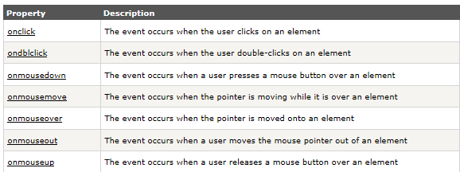
HTML DOM Events
HTML DOM events allow JavaScript to register different event handlers on elements in an HTML document.
Events are normally used in combination with functions, and the function will not be executed before the event occurs (such as when a user clicks a button).
Mouse Events:

Slide 168
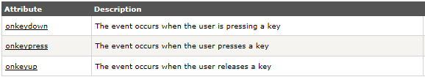
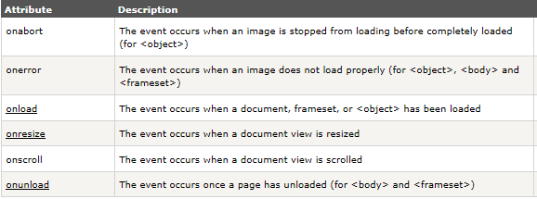
Keyboard Event:
Frame Event

Slide 169
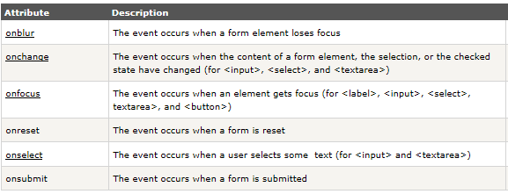
Form Event:

Slide 170
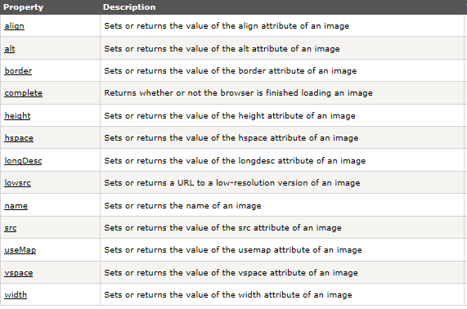
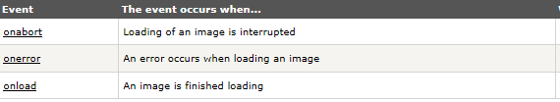
Image

Slide 171
Write a java script program to change size of image when we click on change size button.
Program Output
Write a program to count number of elements with myinput name and display value of first element.
Program output
Write a program to replace one image by another image when we click on changeimage button.
Program output
Write a program to change contents of table cells and count number of rows in table when we click on changecontent button.
Program output

Slide 172
Program to display document title and URL
Program Output
Program to display id , type and button.
Program Output
Program to count number of hyperlinks in the document and display text of first hyperlink.
Program Output
Program to display date
program Output
Program1 Output

Slide 173
<html>
<head> Javascript Events </head>
<body>
<script language="Javascript" type="text/Javascript">
<!--
function clickevent()
{
document.write("This is JavaTpoint");
}
//-->
</script>
<form>
<input type="button" onclick="clickevent()" value="Who's this?"/>
</form>
</body>
</html>
ClickEvent addtwonumberform.html

Slide 174
What is DOM?
The DOM is:
The Document Object Model (DOM) is a programming
defines the logical structure of documents and the way a document is accessed and manipulated.
A standard Document object model for HTML
A standard programming interface for HTML
Platform- and language-independent
A W3C standard (World Wide Web Consortium)
allows programs and scripts to dynamically access
and update the content, structure, and style of a document.
The HTML DOM defines a standard way for accessing and manipulating HTML documents.
The DOM presents an HTML document as a tree-structure.

Slide 175
The HTML DOM (Document Object Model)
When a web page is loaded, the browser creates a Document Object Model of the page.
The HTML DOM model is constructed as a tree of Objects:
The HTML DOM is a standard object model and programming interface for HTML. It defines:
The HTML elements as objects
The properties of all HTML elements
The methods to access all HTML elements
The events for all HTML element

Slide 176
Document Object Model
The HTML DOM is a standard for how to get, change, add, or delete HTML elements.
  Your web browser builds a model of the web page (the document) that includes all the objects in the page (tags, text, etc)
  All of the properties, methods, and events available to the web developer for manipulating and creating web pages are organized into objects
  Those objects are accessible via scripting languages in modern web browsers

Slide 177

The HTML DOM Node Tree (Document Tree)
The HTML DOM views a HTML document as a tree-structure. The tree structure is called a node-tree.

Slide 178
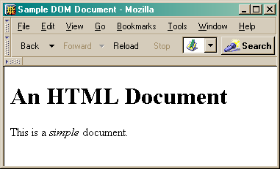
This is what the browser reads
<html>
<head>
<title>Sample DOM Document</title>
</head>
<body>
<h1>An HTML Document</h1>
<p>This is a <i>simple</i> document.
</body>
</html>
This is what the browser displays on screen.

Slide 179
This is a drawing of the model that the browser is working with for the page.(The HTML DOM Node Tree (Document Tree)
Document
<html>
<head>
<body>
<title>
"Sample DOM Document"
<h1>
<p>
"An HTML Document"
"This is a"
<i>
"document"
"simple"

Slide 180
HTML DOM
The DOM says:
The entire document is a document node
Every HTML tag is an element node
The text in the HTML elements are text nodes
Every HTML attribute is an attribute node
Comments are comment nodes
In the HTML DOM the value of the text node can be accessed by the innerHTML property.
Example : inner.html → output

Slide 181
<html>
<body>
<p id="intro">Hi World!</p>
<p id="intro">Hello World!</p>
<p id="main">HTML DOM tutorial</p>
<script type="text/javascript">
txt=document.getElementById("intro").innerHTML;
document.write("Paragraph: " + txt);
</script>
</body>
</html>

Slide 182
DOM references describe the properties and methods of the HTML DOM.
HTML Document
HTML Element
HTML Attribute
HTML Events

Slide 183
The HTML DOM is a standard object model and programming interface for HTML.
It defines:
The HTML elements as objects
The properties of all HTML elements
The methods to access all HTML elements
The events for all HTML elements
In other words: The HTML DOM is a standard for how to get, change, add, or delete HTML elements.

Slide 184
    HTML DOM Nodes
In the HTML DOM (Document Object Model), everything is a node:
•The document itself is a document node
•All HTML elements are element nodes
•All HTML attributes are attribute nodes
•Text inside HTML elements are text nodes
•Comments are comment nodes
    The Document Object
When an HTML document is loaded into a web browser, it becomes a document object.
The document object is the root node of the HTML document and the "owner" of all other nodes:
(element nodes, text nodes, attribute nodes, and comment nodes).
The document object provides properties and methods to access all node objects, from within JavaScript

Slide 185
Example
The JavaScript code to get the text from a <p> element with the id "intro" in a HTML document :
txt=document.getElementById("intro").innerHTML
After the execution of the statement, txt will hold the value "Hi World!"
Explaination:
document - the current HTML document
getElementById("intro") - the <p> element with the id "intro"
innerHTML - the inner text of the HTML element
In the example above, getElementById is a method, while innerHTML is a property.

Slide 186
The HTML DOM Node Tree
The programming interface to the DOM is defined by a set of standard properties and methods.
Properties are often referred to as something that is.
  nodename is "p"
Methods are often referred to as something that is done.
  delete "p"
HTML DOM Properties
x.innerHTML - the inner text value of x (a HTML element)
  x.nodeName - the name of x
  x.nodeValue - the value of x
  x.parentNode - the parent node of x
  Note: In the list above, x is a node object (HTML element).

Slide 187
HTML DOM Methods
x.getElementById(id) - get the element with a specified id
x.getElementsByTagName(name) - get all elements with a specified tag name
x.appendChild(node) - insert a child node to x
x.removeChild(node) - remove a child node from x
Note: In the list above, x is a node object (HTML element).
Example : node.html → output
Example1 output
Example2 Output

Slide 188
Changing an HTML Element
The HTML DOM and JavaScript can be used to change the inner content and attributes of HTML elements dynamically.
Example 1 - Change the Background Color
The following example changes the background color of the <html>
<body> <p> VESIT CHEMBUR !</p>
<script type="text/javascript"> document.body.bgColor="yellow";
</script>
</body>
</html>

Slide 189
Changing the Text HTML Element - innerHTML
The easiest way to get or modify the content of an element is by using the innerHTML property.
Example 2 – Change the Text of an Element
<html>
<body>
<p id="p1">Hello World!</p>
<script type="text/javascript"> document.getElementById("p1").innerHTML=“Vesit Chembur”; </script>
</body>
</html>

Slide 190
Changing an HTML Element Using Events
An event handler allows you to execute code when an event occurs.
Events are generated by the browser when the user clicks an element, when the page loads, when a form is submitted, etc.
Example 3 - Change the Background Color Using onclick Event
<html> <body>
<script type="text/javascript">
document.body.bgColor="yellow";
</script>
<input type="button" onclick="document.body.bgColor=‘blue';" value="Click me to change background color">
</body> </html>

Slide 191
Change the Text font and color of an Element
The following example uses a function to change the style of the <p> element when the button is clicked :
chgtextfont.html → output

Slide 192
HTML DOM Objects Reference
The references describe the properties and methods of each object, along with examples.
Document object
Event object
HTMLElement object
Anchor object
Area object
Base object
Body object
Button object
Form object
Frame/IFrame object
Frameset object

Slide 193
Image object
Input Button object
Input Checkbox object
Input File object
Input Hidden object
Input Password object
Input Radio object
Input Reset object
Input Submit object
Input Text object
Link object
Meta object
Object object

Slide 194
Option object
Select object
Style object
Table object
td / th object
tr object
Textarea object

Slide 195
The DOM refers to a hierarchical collection of objects that allow you to work with HTML documents.
Java script supports various HTML DOM objects. “
The W3C Document Object Model (DOM) is a platform and language-neutral interface that allows programs and scripts to dynamically access and update the content, structure, and style of a document."
The W3C DOM standard is separated into 3 different parts:
Core DOM - standard model for all document types
XML DOM - standard model for XML documents
HTML DOM - standard model for HTML documents

Slide 196
Main Purpose of Browser object is provide an application programming interface between web browser software and Java script language.
Java script statements can directly access and update properties of the Browser objects and call it’s methods.
The parent is the window object.
The window.location contains URL of the web page currently displayed in the browser window.
Window .history stores list of URLS that have been stored in window.location.
Window.navigator stores information about browser type,browser version etc.
Window.document refers to actual web page.
  Window.document.images object returns array of all mages.

Slide 197
JavaScript HTML BROWSER OBJECT MODEL Objects
Object Description :
Window : The top level object in the DOM hierarchy. The Window object represents a browser window. A Window object is created automatically with every instance of a <body> or <frameset> tag.
The Window object and contains in itself several other objects, such as "document", "history" etc.
Navigator : Contains information about the client's display screen.
History : Contains the visited URLs in the browser window.
Location : Contains information about the current URL.
Example : doc.html → output

Slide 198
Links
elements
Window
anchors
button
images
Checkbox
Events
Forms
radio
Applets
Select
Frames
frames
Option
History
Script
Password
Location
body
Submit
Navigator
Selection
Text
Document
Textarea
Screen
Browser Object
Example Output Example1 Output

Slide 199
Object | Description | Properties | Methods
Window | Represents the Web Browser Window | Defaultstatus,name,status,self,closed,history,location,document. | Alert(),close(),confirm(),focus(),open(),print(),prompt()
Navigator | Allows you to access various information about the user's web browser. | AppCodeName,appName,appVersion,cookieenabled,plateform | javaenabled()
Screen | Allows you to access different information about the user screen. | AvailHeight,availWidth,colorDepth,height,width
Location | Allows you to access information about the URL of the web page that is currently opened in the web browser | Host,hostname,href,pathname,port protocol,search. | Assign(),reload(),replace()
Document | Represents the HTML document or web page that is currently opened in the web page. | Lastmodified,title,url | Close(),getElementById(),getElementByName(),getElementByTagName(),open(),write(),writeln()

Slide 200
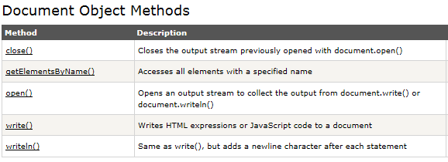

Slide 201
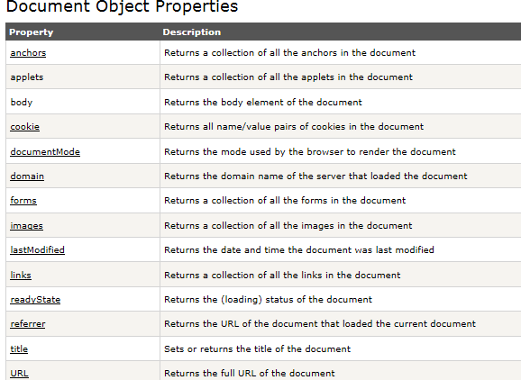

Slide 202
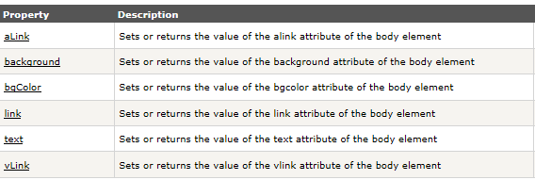
Body Object
The Body object represents the HTML body element.
The body element defines a document's body.
The body element contains all the contents of an HTML document, such as text, hyperlinks, images, tables, lists, etc.
Body Object Properties

Slide 203
Window Object
The window object is primary point from where most objects come.
  document.write(“HELLO”) Is actually
  Windows.document.write(“HELLO”)
  Window1.html → Output
  Window2.html → Output
  Window3.html → Output
Properties | Methods
Defaultstatus,name,status,self,closed,history,location,document. | Alert(),close(),confirm(),focus(),open(),print(),prompt()

Slide 204
Navigator object
The navigator object contains information about the browser.
Example : navig.html → output
Property | Description
appCodeName | Returns the code name of the browser
appName | Returns the name of the browser
appVersion | Returns the version information of the browser
cookieEnabled | Determines whether cookies are enabled in the browser
platform | Returns for which platform the browser is compiled

Slide 205
Location Object
The location object contains information about the current URL.
The location object is part of the window object and is accessed through the window.location property.
location.html → output
Method | Description
assign() | Loads a new document
reload() | Reloads the current document
replace() | Replaces the current document with a new one

Slide 206
Screen Object
The screen object contains information about the visitor's screen.
Screen.html → output
Property | Description
availHeight | Returns the height of the screen (excluding the Windows
availWidth | Returns the width of the screen (excluding the Windows Taskbar)
colorDepth | Returns the bit depth of the color palette for displaying images
height | Returns the total height of the screen
pixelDepth | Returns the color resolution (in bits per pixel) of the screen
width | Returns the total width of the screen

Slide 207
History Object
The history object contains the URLs visited by the user (within a browser window).
The history object is part of the window object and is accessed through the window.history property.
History Object Properties :
  Length : Returns the number of URLs in the history list
History Object Methods :
  back() : Loads the previous URL in the history list
  forward() : Loads the next URL in the history list
  go() : Loads a specific URL from the history list

Slide 208
Events
By using JavaScript, we have the ability to create dynamic web pages. Events are actions that can be detected by JavaScript.
Every element on a web page has certain events which can trigger JavaScript functions.

Slide 209
Examples of events
A mouse click
A web page or an image loading
Mousing over a spot on the web page
Selecting an input box in an HTML form
Submitting an HTML form
A keystroke

Slide 210
Event handler | Applies to: | triggered when:
onAbort | Image | The loading of the image is cancelled.
onBlur | Button, Checkbox, FileUpload, Layer, password, Radio, Reset, Select, Submit, Text, TextArea, Window | The object in question loses focus (e.g. by clicking outside it or pressing the TAB key).
onChange | FileUpload, Select, Text, TextArea | The data in the form element is changed by the user.
onClick | Button, Document, Checkbox, Link, Radio, Reset, Submit | The object is clicked on.
onDblClick | Document, Link | The object is double-clicked on.
onDragDrop | Window | An icon is dragged and dropped into the browser.
onError | Image, Window | A JavaScript error occurs.

Slide 211
Event handler | Applies to: | triggered when:
onFocus | Button, Checkbox, FileUpload, Layer, Password, Radio, Reset, Select, Submit, Text, TextArea, Window | The object in question gains focus (e.g. by clicking on it or pressing the TAB key).
onKeyDown | Document, Image, Link, TextArea | The user presses a key.
onKeyPress | Document, Image, Link, TextArea | The user presses or holds down a key.
onKeyUp | Document, Image, Link, TextArea | The user releases a key
onLoad | Image, Window | The whole page has finished loading.
onMouseDown | Button, Document, Link | The user presses a mouse button.
onMouseMove | window | The user moves the mouse.
onMouseOut | Image, Link | The user moves the mouse away from the object.
onMouseOver | Image, Link | The user moves the mouse over the object.

Slide 212
onMouseUp | Button, Document, Link | The user releases a mouse button.
onMove | Window | The user moves the browser window or frame.
onMouseUp | Button, Document, Link | The user releases a mouse button.
onReset | Form | The user clicks the form's Reset button.
onResize | Window | The user resizes the browser window or frame
onSelect | Text, Textarea | The user selects text within the field
onSubmit | Form | The user clicks the form's Submit button.
onUnload | Window | The user leaves the page.

Slide 213
Window events
onUnload
onLoad
onResize
onMove
onAbort
onError
windoweventProgram Output

Slide 214
Mouse event
mouseclickExample Output
Mouseclickexample1 Output
Mousedownexample Output
MouseOuteventExample Output
Key event
Keydownexample Output
Keyupexample Output
OnfocusExample Output
OnblurExample Output
LoadEvent Output

Slide 215
HTML DOM Events
HTML DOM events allow JavaScript to register different event handlers on elements in an HTML document.
Events are normally used in combination with functions, and the function will not be executed before the event occurs (such as when a user clicks a button).
Mouse Events:

Slide 216
Keyboard Event:
Frame Event

Slide 217
Form Event:

Slide 218
Image

Slide 219
Write a java script program to change size of image when we click on change size button.
Program Output
Write a program to count number of elements with myinput name and display value of first element.
Program output
Write a program to replace one image by another image when we click on changeimage button.
Program output
Write a program to change contents of table cells and count number of rows in table when we click on changecontent button.
Program output

Slide 220
Program to display document title and URL
Program Output
Program to display id , type and button.
Program Output
Program to count number of hyperlinks in the document and display text of first hyperlink.
Program Output
Program to display date
program Output
Program1 Output

Slide 221
JavaScript Form Validation
Example of JavaScript validation
JavaScript email validation
It is important to validate the form submitted by the user because it can have inappropriate values. So, validation is must to authenticate user.
JavaScript provides facility to validate the form on the client-side so data processing will be faster than server-side validation.
Most of the web developers prefer JavaScript form validation.
Through JavaScript, we can validate name, password, email, date, mobile numbers and more fields.

Slide 222
JavaScript Form Validation Example
In this example, we are going to validate the name and password. The name can’t be empty and password can’t be less than 6 characters long.
Here, we are validating the form on form submit. The user will not be forwarded to the next page until given values are correct.
<script>
function validateform(){
var name=document.myform.name.value;
var password=document.myform.password.value;
if (name==null || name==""){
alert("Name can't be blank");
return false;
}else if(password.length<6){
alert("Password must be at least 6 characters long.");
return false;
}
}
</script>

Slide 223
<body>
<form name="myform" method="post" action="abc.jsp" onsubmit="return validateform()" >
Name: <input type="text" name="name"><br/>
Password: <input type="password" name="password"><br/>
<input type="submit" value="register">
</form>

Slide 224
JavaScript Retype Password Validation
<script type="text/javascript">
function matchpass(){
var firstpassword=document.f1.password.value;
var secondpassword=document.f1.password2.value;
if(firstpassword==secondpassword){
return true;
}
else{
alert("password must be same!");
return false;
}
}
</script>

Slide 225
<form name="f1" action="register.jsp" onsubmit="return matchpass()">
Password:<input type="password" name="password" /><br/>
Re-enter Password:<input type="password" name="password2"/><br/>
<input type="submit">
</form>

Slide 226
JavaScript Number Validation
Let's validate the textfield for numeric value only. Here, we are using isNaN() function.
<script>
function validate(){
var num=document.myform.num.value;
if (isNaN(num)){
document.getElementById("numloc").innerHTML="Enter Numeric value only";
return false;
}else{
return true;
}
}
</script>

Slide 227
JavaScript email validation
We can validate the email by the help of JavaScript.
There are many criteria that need to be follow to validate the email id such as:
email id must contain the @ and . character
There must be at least one character before and after the @.
There must be at least two characters after . (dot).

Slide 228
<form name="myform" onsubmit="return validate()" >
Number: <input type="text" name="num"><span id="numloc"></span><br/>
<input type="submit" value="submit">
</form>

Slide 229
<script>
function validateemail()
{
var x=document.myform.email.value;
var atposition=x.indexOf("@");
var dotposition=x.lastIndexOf(".");
if (atposition<1 || dotposition<atposition+2 || dotposition+2>=x.length){
alert("Please enter a valid e-mail address \n atpostion:"+atposition+"\n dotposition:"+dotposition);
return false;
}
}
</script>

Slide 230
<body>
<form name="myform" method="post" action="#" onsubmit="return validateemail();">
Email: <input type="text" name="email"><br/>
<input type="submit" value="register">
</form>

Slide 231
Phone Number validation
The validating phone number is an important point while validating an HTML form.
In this page we have discussed how to validate a phone number (in different format) using JavaScript :
At first, we validate a phone number of 10 digits with no comma, no spaces, no punctuation and there will be no + sign in front the number.
Simply the validation will remove all non-digits and permit only phone numbers with 10 digits. Here is the function.

Slide 232
function phonenumber(inputtxt)
{
var phoneno = /^\d{10}$/;
if((inputtxt.value.match(phoneno))
{
return true;
}
else
{
alert("message");
return false;
}
}

Slide 233
function phonenumber(inputtxt)
{
var phoneno = /^\(?([0-9]{3})\)?[-. ]?([0-9]{3})[-. ]?([0-9]{4})$/;
if((inputtxt.value.match(phoneno))
{
return true;
}
else
{
alert("message");
return false;
}
}

Slide 234
Validate a 10 digit phone number
At first we validate a phone number of 10 digit. For example 1234567890, 0999990011, 8888855555 etc.
HTML Code

Slide 235
<!DOCTYPE html>
<html lang="en">
<head>
<meta charset="utf-8">
<title>JavaScript form validation - checking non-empty</title>
<link rel='stylesheet' href='form-style.css' type='text/css' />
</head><body onload='document.form1.text1.focus()'>
<div class="mail">
<h2>Input an Phone No.[xxxxxxxxxx] and Submit</h2>
<form name="form1" action="#">
<ul>
<li><input type='text' name='text1'/></li>
<li>&nbsp;</li>
<li class="submit"><input type="submit" name="submit" value="Submit" onclick="phonenumber(document.form1.text1)"/></li>
<li>&nbsp;</li>
</ul>
</form>

Slide 236
</div>
<script src="phoneno-all-numeric-validation.js"></script>
</body>
</html>

Slide 237
function phonenumber(inputtxt)
{
var phoneno = /^\d{10}$/;
if(inputtxt.value.match(phoneno))
{
return true;
}
else
{
alert("Not a valid Phone Number");
return false;
}
}

Slide 238
JavaScript provides in-built functions to check whether the array is empty or not. Following are the method offered by JavaScript programming to check an empty array:
length
isArray(array)
The Array.isArray() function checks the array type (passed parameter is an array or not) and array.length find the length of the array.

Slide 239
.length property
The length property returns the length of the array by which you can determine whether the array is empty or not.
This property is directly used with the name of array concatenated by dot (.) operator, e.g., arr1.length.
Syntax
array.length
If the length returned by this property is 0, it refers to true means the array is empty. Otherwise, the array is not empty if it returns a non-zero value.

Slide 240
<script>
var arr1 = [15, 78, 24, 89, 23];
var arr2 = [];
//check second array (arr2) length
if(arr1.length == 0)
document.write("arr1 is empty <br>");
else
document.write("arr1 is not empty <br>");
//check second array (arr2) length
if(arr2.length == 0)
document.write("arr2 is empty <br>");
else
document.write("arr2 is not empty <br>");
</script>

Slide 241
In JavaScript, arrays are objects.
So, if you check the type of array using typeof property, it will return value as an object.
But now we have Array.isArray() function to check the type of array, which can be used with .length property to check empty array.
Syntax
Array.isArray(arr1)
It returns a Boolean value, either true or false.

Slide 242
<html>
<head>
<script type="text/javascript">
function Focus_In (event) {
event.srcElement.style.color = "red";
}
function Focus_Out (event) {
event.srcElement.style.color = "blue";
}
</script>
</head>

Slide 243
<body>
<center> <h3>Click on the textbox and observe </h3><br></br>
<form onfocusin="Focus_In (event)" onfocusout="Focus_Out (event)">
<b> User name: <input type="text value="Username"/></b><br/>
<br>
<b> Password <input type="password" value="*******"/></b> </center>
</form>
</body>
</html>

Slide 244
JavaScript eval() function
The eval() function in JavaScript is used to evaluate the expression.
It is JavaScirpt's global function, which evaluates the specified string as JavaScript code and executes it.
The parameter of the eval() function is a string.
If the parameter represents the statements, eval() evaluates the statements.
If the parameter is an expression, eval() evaluates the expression.
If the parameter of eval() is not a string, the function returns the parameter unchanged.
There are some limitations of using the eval() function, such as the eval() function is not recommended to use because of the security reasons.
It is not suggested to use because it is slower and makes code unreadable.

Slide 245
Syntax
eval(string)
Values
It accepts a single parameter, which is defined as follows.
string: It represents a JavaScript expression, single statement, or the sequence of statements.
It can be a variable, statement, or a JavaScript expression.
Let's understand the JavaScript eval() function by using illustrations.

Slide 246
<html>
<head>
<script>
var a = 10, b = 20, c = 30, sum, mul, sub;
sum = eval(" a + b + c ");
mul = eval(" a * b * c");
sub = eval(" a - b");
document.write(sum + "<br>");
document.write(mul + "<br>");
document.write(sub);
</script>
</head>
<body>
</body>
</html>

Slide 247
Exception Handling in JavaScript
An exception signifies the presence of an abnormal condition which requires special operable techniques.
In programming terms, an exception is the anomalous code that breaks the normal flow of the code.
Such exceptions require specialized programming constructs for its execution.
What is Exception Handling
In programming, exception handling is a process or method used for handling the abnormal statements in the code and executing them.
It also enables to handle the flow control of the code/program.
For handling the code, various handlers are used that process the exception and execute the code.
For example, the Division of a non-zero value with zero will result into infinity always, and it is an exception.
Thus, with the help of exception handling, it can be executed and handled.

Slide 248
In exception handling:
A throw statement is used to raise an exception. It means when an abnormal condition occurs, an exception is thrown using throw.
The thrown exception is handled by wrapping the code into the try…catch block. If an error is present, the catch block will execute, else only the try block statements will get executed.
Types of Errors
While coding, there can be three types of errors in the code:
Syntax Error: When a user makes a mistake in the pre-defined syntax of a programming language, a syntax error may appear.
Runtime Error: When an error occurs during the execution of the program, such an error is known as Runtime error. The codes which create runtime errors are known as Exceptions. Thus, exception handlers are used for handling runtime errors.
Logical Error: An error which occurs when there is any logical mistake in the program that may not produce the desired output, and may terminate abnormally. Such an error is known as Logical error.

Slide 249
Error Object
When a runtime error occurs, it creates and throws an Error object. Such an object can be used as a base for the user-defined exceptions too. An error object has two properties:
name: This is an object property that sets or returns an error name.
message: This property returns an error message in the string form.
Although Error is a generic constructor, there are following standard built-in error types or error

Slide 250
Although Error is a generic constructor, there are following standard built-in error types or error constructors beside it:
EvalError: It creates an instance for the error that occurred in the eval(), which is a global function used for evaluating the js string code.
InternalError: It creates an instance when the js engine throws an internal error.
RangeError: It creates an instance for the error that occurs when a numeric variable or parameter is out of its valid range.
ReferenceError: It creates an instance for the error that occurs when an invalid reference is de-referenced.
SyntaxError: An instance is created for the syntax error that may occur while parsing the eval().
TypeError: When a variable is not a valid type, an instance is created for such an error.
URIError: An instance is created for the error that occurs when invalid parameters are passed in encodeURI() or decodeURI().

Slide 251
Exception Handling Statements
There are following statements that handle if any exception occurs:
throw statements
try…catch statements
try…catch…finally statements.

Slide 252
JavaScript try…catch
A try…catch is a commonly used statement in various programming languages. Basically, it is used to handle the error-prone part of the code.
It initially tests the code for all possible errors it may contain, then it implements actions to tackle those errors (if occur).
A good programming approach is to keep the complex code within the try…catch statements.
try{} statement: Here, the code which needs possible error testing is kept within the try block. In case any error occur, it passes to the catch{} block for taking suitable actions and handle the error.
Otherwise, it executes the code written within.
catch{} statement: This block handles the error of the code by executing the set of statements written within the block.
This block contains either the user-defined exception handler or the built-in handler.
This block executes only when any error-prone code needs to be handled in the try block. Otherwise, the catch block is skipped.

Slide 253
Syntax:
try{
expression; } //code to be written.
catch(error){
expression; } // code for handling the error.
try…catch example
<html>
<head> Exception Handling</br></head>
<body>
<script>

Slide 254
try{
var a= ["34","32","5","31","24","44","67"]; //a is an array
document.write(a); // displays elements of a
document.write(b); //b is undefined but still trying to fetch its value. Thus catch block will be invoked
}catch(e){
alert("There is error which shows "+e.message); //Handling error
}
</script>
</body>
</html>

Slide 255
Throw Statement
Throw statements are used for throwing user-defined errors. User can define and throw their own custom errors.
When throw statement is executed, the statements present after it will not execute. The control will directly pass to the catch block.
Syntax:
throw exception;

Slide 256
try…catch…throw syntax
try{
throw exception; // user can define their own exception
}
catch(error){
expression; } // code for handling exception.

Slide 257
throw example with try…catch
<html>
<head>Exception Handling</head>
<body>
<script>
try {
throw new Error('This is the throw keyword'); //user-defined throw statement.
}
catch (e) {
document.write(e.message); // This will generate an error message
}
</script>
</body>
</html>

Slide 258
try…catch…finally statements
Finally is an optional block of statements which is executed after the execution of try and catch statements.
Finally block does not hold for the exception to be thrown. Any exception is thrown or not, finally block code, if present, will definitely execute.
It does not care for the output too.
Syntax:
try{
expression;
}
catch(error){
expression;
}
finally{
expression; } //Executable code

Slide 259
try…catch…finally example
<html>
<head>Exception Handling</head>
<body>
<script>
try{
var a=2;
if(a==2)
document.write("ok");
}
catch(Error){
document.write("Error found"+e.message);
}
finally{
document.write("Value of a is 2 ");
}
</script>
</body>
</html>

Slide 260
<html>
<head>
<script>
function ageCalculator()
{
var userinput = document.getElementById("DOB").value;
var dob = new Date(userinput);
if(userinput==null || userinput==‘’)
{
document.getElementById("message").innerHTML = "**Choose a date please!";
return false;
}
else
{
//calculate month difference from current date in time
var month_diff = Date.now() - dob.getTime();

Slide 261
//convert the calculated difference in date format
var age_dt = new Date(month_diff);
//extract year from date
var year = age_dt.getUTCFullYear();
//now calculate the age of the user
var age = Math.abs(year - 1970);
//display the calculated age
return document.getElementById("result").innerHTML =
"Age is: " + age + " years. ";
}
}

Slide 262
</script>
</head>
<body>
<center>
<h2 style="color: 32A80F" align="center"> Calculate Age from Date of Birth <br> <br> </h2>
<!-- Choose a date and enter in input field -->
<b> Enter Date of Birth: <input type=date id = DOB> </b>
<span id = "message" style="color:red"> </span> <br><br>
<!-- Choose a date and enter in input field -->
<button type="submit" onclick = "ageCalculator()"> Calculate age </button> <br><br>
<h3 style="color:32A80F" id="result" align="center"></h3>
</center>
</body>
</html>

Slide 263
JavaScript Classes
In JavaScript, classes are the special type of functions.
We can define the class just like function declarations and function expressions.
The JavaScript class contains various class members within a body including methods or constructor.
The class is executed in strict mode.
So, the code containing the silent error or mistake throws an error.
The class syntax contains two components:
Class declarations
Class expressions

Slide 264
Class Declarations
A class can be defined by using a class declaration.
A class keyword is used to declare a class with any particular name.
According to JavaScript naming conventions, the name of the class always starts with an uppercase letter.

Slide 265
Class Declarations Example
<script>
//Declaring class
class Employee
{
//Initializing an object
constructor(id,name)
{
this.id=id;
this.name=name;
}
//Declaring method
detail()
{
document.writeln(this.id+" "+this.name+"<br>")
}
}

Slide 266
//passing object to a variable
var e1=new Employee(101,"Martin Roy");
var e2=new Employee(102,"Duke William");
e1.detail(); //calling method
e2.detail();
</script>

Slide 267
JavaScript Objects
A javaScript object is an entity having state and behavior (properties and method). For example: car, pen, bike, chair, glass, keyboard, monitor etc.
JavaScript is an object-based language. Everything is an object in JavaScript.
Creating Objects in JavaScript
There are 3 ways to create objects.
By object literal
By creating instance of Object directly (using new keyword)
By using an object constructor (using new keyword)

Slide 268
1) JavaScript Object by object literal
The syntax of creating object using object literal is given below:
object={property1:value1,property2:value2.....propertyN:valueN}
As you can see, property and value is separated by : (colon).
Let’s see the simple example of creating object in JavaScript.
<script>
emp={id:102,name:"Shyam Kumar",salary:40000}
document.write(emp.id+" "+emp.name+" "+emp.salary);
</script>

Slide 269
2) By creating instance of Object
The syntax of creating object directly is given below:
var objectname=new Object();
/*Here, new keyword is used to create object.
Let’s see the example of creating object directly.*/
<script>
var emp=new Object();
emp.id=101;
emp.name="Ravi Malik";
emp.salary=50000;
document.write(emp.id+" "+emp.name+" "+emp.salary);
</script>

Slide 270
3) By using an Object constructor
Here, you need to create function with arguments. Each argument value can be assigned in the current object by using this keyword.
The this keyword refers to the current object.
The example of creating object by object constructor is given below.
<script>
function emp(id,name,salary){
this.id=id;
this.name=name;
this.salary=salary;
}
e=new emp(103,"Vimal Jaiswal",30000);
document.write(e.id+" "+e.name+" "+e.salary);
</script>

Slide 271
Defining method in JavaScript Object
We can define method in JavaScript object. But before defining method, we need to add property in the function with same name as method.
The example of defining method in object is given below.
<script>
function emp(id,name,salary){
this.id=id;
this.name=name;
this.salary=salary;
this.changeSalary=changeSalary;
function changeSalary(otherSalary){
this.salary=otherSalary;
}
}

Slide 272
e=new emp(103,"Sonoo Jaiswal",30000);
document.write(e.id+" "+e.name+" "+e.salary);
e.changeSalary(45000);
document.write("<br>"+e.id+" "+e.name+" "+e.salary);
</script>

Slide 273
<script>
function Employee(firstName,lastName)
{
this.firstName=firstName;
this.lastName=lastName;
}
Employee.prototype.company="Javatpoint"
var employee1=new Employee("Martin","Roy");
var employee2=new Employee("Duke", "William");
document.writeln(employee1.firstName+" "+employee1.lastName+" "+employee1.company+"<br>");
document.writeln(employee2.firstName+" "+employee2.lastName+" "+employee2.company);
</script>

Slide 274
JavaScript Encapsulation
The JavaScript Encapsulation is a process of binding the data (i.e. variables) with the functions acting on that data.
It allows us to control the data and validate it.
To achieve an encapsulation in JavaScript: -
Use var keyword to make data members private.
Use setter methods to set the data and getter methods to get that data.

Slide 275
<script>
class Student
{
constructor()
{
var name;
var marks;
}
getName()
{
return this.name;
}
setName(name)
{
this.name=name;
}

Slide 276
getMarks()
{
return this.marks;
}
setMarks(marks)
{
this.marks=marks;
}
}
var stud=new Student();

Slide 277
JavaScript Inheritance
The JavaScript inheritance is a mechanism that allows us to create new classes on the basis of already existing classes.
It provides flexibility to the child class to reuse the methods and variables of a parent class.
The JavaScript extends keyword is used to create a child class on the basis of a parent class.
It facilitates child class to acquire all the properties and behavior of its parent class.

Slide 278
It maintains an IS-A relationship.
The extends keyword is used in class expressions or class declarations.
Using extends keyword, we can acquire all the properties and behavior of the inbuilt object as well as custom classes.
We can also use a prototype-based approach to achieve inheritance.
<script>
class Moment extends Date
{
constructor() {
super();
}
}
var m=new Moment();
document.writeln("Current date:")
document.writeln(m.getDate()+"-"+(m.getMonth()+1)+"-"+m.getFullYear());
</script>

Slide 279
<script>
class Bike
{
constructor()
{
this.company="Honda";
}
}
class Vehicle extends Bike {
constructor(name,price) {
super();
this.name=name;
this.price=price;
}
}
var v = new Vehicle("Shine","70000");
document.writeln(v.company+" "+v.name+" "+v.price);
</script>

Slide 280
Access Modifiers in JavaScript
Access modifiers are keywords used to specify the declared accessibility of a member or a type.
The followings are the access modifiers in most of the object oriented programs.
Private – Access is limited.
Public – Can be access from anywhere, access is not restricted.
Privileged/Protected – Access is limited to the containing class or types derived from the containing class.

Slide 281
JavaScript Polymorphism
The polymorphism is a core concept of an object-oriented paradigm that provides a way to perform a single action in different forms.
It provides an ability to call the same method on different JavaScript objects.
As JavaScript is not a type-safe language, we can pass any type of data members with the methods.

Slide 282
JavaScript Polymorphism Example 1
Let's see an example where a child class object invokes the parent class method.
<script>
class A
{
display()
{
document.writeln("A is invoked");
}
}
class B extends A
{
}
var b=new B();
b.display();
</script>

Slide 283
<script>
class A
{
display()
{
document.writeln("A is invoked<br>");
}
}
class B extends A
{
display()
{
document.writeln("B is invoked");
}
}

Slide 284
var a=[new A(), new B()]
a.forEach(function(msg)
{
msg.display();
});
</script>
Output:
A is invoked
B is invoked

Slide 285
Creating New HTML Elements (Nodes)
To add a new element to the HTML DOM, you must create the element (element node) first, and then append it to an existing element.
<div id="div1">
<p id="p1">This is a paragraph.</p>
<p id="p2">This is another paragraph.</p>
</div>
<script>
const para = document.createElement("p");
const node = document.createTextNode("This is new.");
para.appendChild(node);
const element = document.getElementById("div1");
element.appendChild(para);
</script>

Slide 286
JavaScript Inheritance
The JavaScript inheritance is a mechanism that allows us to create new classes on the basis of already existing classes.
It provides flexibility to the child class to reuse the methods and variables of a parent class.
The JavaScript extends keyword is used to create a child class on the basis of a parent class.
It facilitates child class to acquire all the properties and behavior of its parent class.

Slide 287
As JavaScript is widely used in Web Development, in this article we would explore some of the Object Oriented mechanism supported by JavaScript to get most out of it.
Some of the common interview question in JavaScript on OOPS includes,- “How Object-Oriented Programming is implemented in JavaScript?
How they differ from other languages? Can you implement Inheritance in JavaScript and so on…”
There are certain features or mechanisms which makes a Language Object-Oriented like:
Object
Classes
Encapsulation
Inheritance

Slide 288
Object–
An Object is a unique entity which contains property and methods. For example “car” is a real life Object, which have some characteristics like color, type, model, horsepower and performs certain action like drive.
The characteristics of an Object are called as Property, in Object Oriented Programming and the actions are called methods.
An Object is an instance of a class. Objects are everywhere in JavaScript almost every element is an Object whether it is a function, arrays and string.
Note: A Method in javascript is a property of an object whose value is a function.

Slide 289
Object can be created in two ways in JavaScript:
Using an Object Literal
//Defining object
let person = {
first_name:'Mukul',
last_name: 'Latiyan',
//method
getFunction : function(){
return (`The name of the person is
${person.first_name} ${person.last_name}`)
},
//object within object
phone_number : {
mobile:'12345',
landline:'6789'
}
}

Slide 290
console.log(person.getFunction());
console.log(person.phone_number.landline);

Slide 291
Using an Object Constructor:
//using a constructor
function person(first_name,last_name){
this.first_name = first_name;
this.last_name = last_name;
}
//creating new instances of person object
let person1 = new person('Mukul','Latiyan');
let person2 = new person('Rahul','Avasthi');
console.log(person1.first_name);
console.log(`${person2.first_name} ${person2.last_name}`);

Slide 292
Classes–
Classes are blueprint of an Object.
A class can have many Object, because class is a template while Object are instances of the class or the concrete implementation.
Before we move further into implementation, we should know unlike other Object Oriented Language there is no classes in JavaScript we have only Object.
To be more precise, JavaScript is a prototype based object oriented language, which means it doesn’t have classes rather it define behaviors using constructor function and then reuse it using the prototype.

Slide 293
Lets use ES6 classes then we will look into traditional way of defining Object and simulate them as classes.
// Defining class using es6
class Vehicle {
constructor(name, maker, engine) {
this.name = name;
this.maker = maker;
this.engine = engine;
}
getDetails(){
return (`The name of the bike is ${this.name}.`)
}
}

Slide 294
// Making object with the help of the constructor
let bike1 = new Vehicle('Hayabusa', 'Suzuki', '1340cc');
let bike2 = new Vehicle('Ninja', 'Kawasaki', '998cc');
console.log(bike1.name); // Hayabusa
console.log(bike2.maker); // Kawasaki
console.log(bike1.getDetails());

Slide 295
Encapsulation – The process of wrapping property and function within a single unit is known as encapsulation.
class person{
constructor(name,id){
this.name = name;
this.id = id;
}
add_Address(add){
this.add = add;
}
getDetails(){
console.log(`Name is ${this.name},Address is: ${this.add}`);
}
}

Slide 296
let person1 = new person('Mukul',21);
person1.add_Address('Delhi');
person1.getDetails();

Slide 297
Encapsulation – The process of wrapping property and function within a single unit is known as encapsulation.
//encapsulation example
class person{
constructor(name,id){
this.name = name;
this.id = id;
}
add_Address(add){
this.add = add;
}
getDetails(){
console.log(`Name is ${this.name},Address is: ${this.add}`);
}
}

Slide 298
let person1 = new person('Mukul',21);
person1.add_Address('Delhi');
person1.getDetails();

Slide 299
JavaScript Class Syntax
Use the keyword class to create a class.
Always add a method named constructor():
Syntax
class ClassName {
constructor() { ... }
}

Slide 300
class Car {
constructor(name, year) {
this.name = name;
this.year = year;
}
}
The example above creates a class named "Car".
The class has two initial properties: "name" and "year".
A JavaScript class is not an object.
It is a template for JavaScript objects.

Slide 301
Using a Class
When you have a class, you can use the class to create objects:
Example
let myCar1 = new Car("Ford", 2014);
let myCar2 = new Car("Audi", 2019);

Slide 302
The Constructor Method
The constructor method is a special method:
It has to have the exact name "constructor"
It is executed automatically when a new object is created
It is used to initialize object properties
If you do not define a constructor method, JavaScript will add an empty constructor method.

Slide 303
Class Methods
Class methods are created with the same syntax as object methods.
Use the keyword class to create a class.
Always add a constructor() method.
Then add any number of methods.
Syntax
class ClassName
{
constructor() { ... }
method_1() { ... }
method_2() { ... }
method_3() { ... }
}

Slide 304
class Car {
constructor(name, year) {
this.name = name;
this.year = year;
}
age() {
let date = new Date();
return date.getFullYear() - this.year;
}
}
let myCar = new Car("Ford", 2014);
document.getElementById("demo").innerHTML =
"My car is " + myCar.age() + " years old.";

Slide 305
class Car {
constructor(name, year) {
this.name = name;
this.year = year;
}
age(x) {
return x - this.year;
}
}
let date = new Date();
let year = date.getFullYear();
let myCar = new Car("Ford", 2014);
document.getElementById("demo").innerHTML=
"My car is " + myCar.age(year) + " years old.";

Slide 306
Class Inheritance
To create a class inheritance, use the extends keyword.
A class created with a class inheritance inherits all the methods from another class:

Slide 307
class Car {
constructor(brand) {
this.carname = brand;
}
present() {
return 'I have a ' + this.carname;
}
}
class Model extends Car {
constructor(brand, mod) {
super(brand);
this.model = mod;
}
show() {
return this.present() + ', it is a ' + this.model;
}
}
let myCar = new Model("Ford", "Mustang");
document.getElementById("demo").innerHTML = myCar.show();
Th

Slide 308
The super() method refers to the parent class.
By calling the super() method in the constructor method, we call the parent's constructor method and gets access to the parent's properties and methods.

Slide 309
class Animal {
constructor(legs) {
this.legs = legs;
}
walk() {
console.log('walking on ' + this.legs + ' legs');
}
}
class Bird extends Animal {
constructor(legs) {
super(legs);
}
fly() {
console.log('flying');
}
}

Slide 310
let bird = new Bird(2);
bird.walk();
bird.fly();

Slide 311
Iterators and generators:
Iterators are a new way to loop over any collection in JavaScript.
An iterable is a data structure that wants to make its elements accessible to the public.
It does so by implementing a method whose key is Symbol.iterator.
It will create iterators.
An iterator is a pointer for traversing the elements of a data structure.

Slide 312
Iterable values in Javascript
The following values are iterable:
Arrays
Strings
Maps
Sets

Slide 313
The idea of iterability is as follows.
Data consumers:
JavaScript has language constructs that consume data.
For example, for-of loops over values and the spread operator (...) inserts values into Arrays or function calls.
Data sources:
The data consumers could get their values from a variety of sources.
For example, you may want to iterate over the elements of an Array, the key-value entries in a Map or the characters of a string.

Slide 314
An iterator is an object that can access one item at a time from a collection while keeping track of its current position
It just requires that you have a method called next() to move to the next item to be a valid iterator
The result of next() is always an object with two properties –
Value: The value in the iteration sequence
Done: true | false

Slide 315
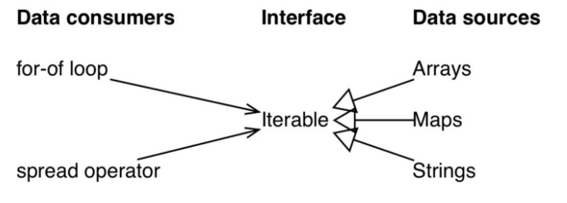

Slide 316
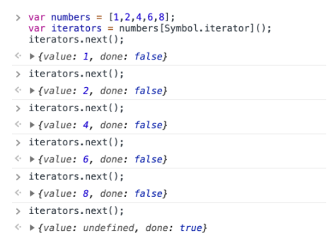
Symbol.iterator
The Symbol.iterator is a special-purpose symbol made especially for accessing an object's internal iterator.
So, you could use it to retrieve a function that iterates over an array object, like so –

Slide 317
Making objects iterable
So as we learnt in the previous section, we need to implement a method called Symbol.iterator.
We will use computed property syntax to set this key.
const array = ['a', 'b', 'c', 'd', 'e'];
const iterator = array[Symbol.iterator]();
const first = iterator.next().value
iterator.next().value // Since it was skipped, so it's not assigned
const third = iterator.next().value
iterator.next().value // Since it was skipped, so it's not assigned
const last = iterator.next().value

Slide 318
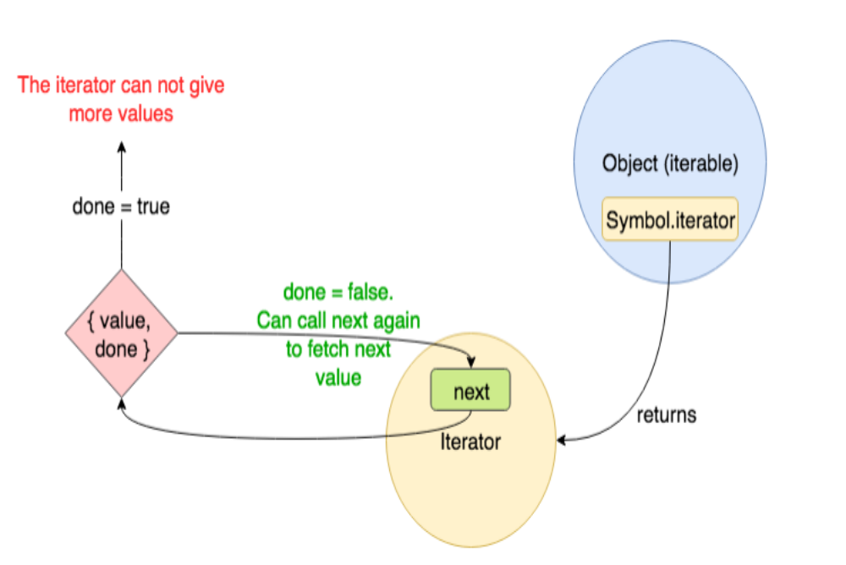

Slide 319
What is an Iterator and how does it work?
There are many ways to loop through a data structure in JavaScript.
For example, using a for loop or using a while loop.
An Iterator has similar functionality but with a significant difference.
An iterator only needs to know the current position in the collection as opposed to other loops where they require to load the entire collection upfront in order to loop through it.
Iterators use the next() method to access the next element in the collection.
However, in order to use an Iterator the value or data structure should be iterable.
Arrays, Strings, Maps, Sets are some of the iterables in JavaScript.
A normal object is not iterable.

Slide 320
Why is Iterator better than a normal for loop?
Iterators are better in some cases.
For example, in ordered collections such as Arrays, with no random access, Iterators perform better as they can retrieve elements directly based on the current position.

Slide 321
Iterators improve efficiency by letting you consume a list of items, one at a time, similar to a stream of data.
Generators are a special kind of function capable of pausing the execution.
Invoking a generator allows producing data in chunks (one at a time) without storing it in a list first.
Then, why do we need Iterators?
Remember, using a normal looping algorithm, such as for loop or while loop , you can only loop through collections that allow iterations.

Slide 322
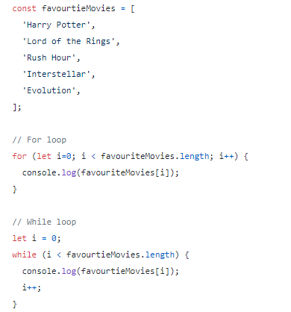
Let’s look at an example.

Slide 323
Since an Array is iterable, using the for loop to traverse through the list possible.
We can implement an iterator for the above as well, which will allow better access to elements based on the current position, without loading the entire collection.
Implementing an iterator to the above would be as follows.

Slide 324
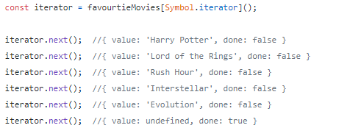

Slide 325
The next() method will return the Iterator result.
This consists of two values; the element in the collection and the done status.
As you can see, when the traversing is complete, even if we access an element out of the bounds of the array, it won’t throw an error.
It would simply return an object with a undefined value and a done status as true .
Iterators improve efficiency by letting you consume a list of items, one at a time, similar to a stream of data.
Generators are a special kind of function capable of pausing the execution.
Invoking a generator allows producing data in chunks (one at a time) without storing it in a list first.

Slide 326
Introduction to Symbol
ES6 introduces a new primitive type called Symbol.
They are helpful to implement metaprogramming in JavaScript programs.
Syntax
const mySymbol = Symbol()
const mySymbol = Symbol(stringDescription)
A symbol is just a piece of memory in which you can store some data.
Each symbol will point to a different memory location.
Values returned by a Symbol() constructor are unique and immutable.

Slide 327
Let us understand this through an example.
Initially, we created two symbols without description followed by symbols with same description.
In both the cases the equality operator will return false when the symbols are compared.
<script>
const s1 = Symbol();
const s2 = Symbol();
console.log(typeof(s1))
console.log(s1===s2)
const s3 = Symbol("hello");//description
const s4 = Symbol("hello");
console.log(s3)
console.log(s4)
console.log(s3==s4)
</script>

Slide 328
The output of the above code will be as mentioned below −
symbol
false
Symbol(hello)
Symbol(hello)
false

Slide 329
Symbol.for(key)
searches for existing symbols in a symbol registry with the given key and returns it, if found.
Otherwise, a new symbol gets created in the global symbol registry with this key.
Symbol.keyFor(sym)
Retrieves a shared symbol key from the global symbol registry for the given symbol.

Slide 330
This function creates a symbol and adds to registry.
If the symbol is already present in the registry it will return the same; else a new symbol is created in the global symbol registry.
Syntax
Symbol.for(key)
where, key is the identifier of the symbol

Slide 331
The following example shows the difference between Symbol() and Symbol.for()
<script>
const userId = Symbol.for('userId') // creates a new Symbol in registry
const user_Id = Symbol.for('userId') // reuses already created Symbol
console.log(userId == user_Id)
const studentId = Symbol("studentID") // creates symbol but not in registry
const student_Id = Symbol.for("studentID")// creates a new Symbol in registry
console.log(studentId == student_Id)
</script>

Slide 332
The output of the above code will be as shown below −
true
false

Slide 333
Generator-Function :
A generator-function is defined like a normal function, but whenever it needs to generate a value, it does so with the yield keyword rather than return.
The yield statement suspends function’s execution and sends a value back to caller, but retains enough state to enable function to resume where it is left off.
When resumed, the function continues execution immediately after the last yield run.

Slide 334
A Generator is
A function that generates a series of values instead of a single value and can pause and resume when required during the execution.
function* is the syntax used to write generator functions.
It includes an operator called yield which allows pausing the generator function itself until the next value is requested.
example of a generator would be as follows.

Slide 335
How does a Generator function differ from a normal function?
As we all know, a normal function cannot pause until its execution is completed.
The only method to break out of a normal function would be to use the return keyword.
The following diagram gives a high-level picture of the difference between a normal function and a generator function.

Slide 336
Syntax :
// An example of generator function
function* gen(){
yield 1;
yield 2;
...
...
}

Slide 337
Generator-Object :
Generator functions return a generator object.
Generator objects are used either by calling the next method on the generator object or using the generator object in a “for of” loop (as shown in the above program)
The Generator object is returned by a generating function and it conforms to both the iterable protocol and the iterator protocol.

Slide 338
<script>
// Generate Function generates three
// different numbers in three calls
function * fun()
{
yield 10;
yield 20;
yield 30;
}
// Calling the Generate Function
var gen = fun();
document.write(gen.next().value);
document.write("<brte(gen.next().value);
document.wri>");
document.write("<br>");
document.write(gen.next().value);
</script>

Slide 339
<script>// Generate Function generates an
// infinite series of Natural Numbers
function * nextNatural()
{
var naturalNumber = 1;
// Infinite Generation
while (true) {
yield naturalNumber++;
}
}
// Calling the Generate Function
var gen = nextNatural();
// Loop to print the first
// 10 Generated number
for (var i = 0; i < 10; i++) {
// Generating Next Number
document.write(gen.next().value);
// New Line
document.write("<br>");
} </script>

Slide 340
Output
1
2
3
4
5
6
7
8
9
10

Slide 341
<script>
var array = ['a', 'b', 'c'];
function* generator(arr) {
let i = 0;
while (i < arr.length) {
yield arr[i++]
}
}
const it = generator(array);
// we can do it.return() to finish the generator
</script>

Slide 342
Encountering yield and yield* syntax
yield : pauses the generator execution and it returns the value of the expression which is being written after the yield keyword.
yield* : it iterates over the operand and returns each value until done is true.

Slide 343
<script>
const arr = ['a', 'b', 'c'];
function* generator() {
yield 1;
yield* arr;
yield 2;
}
for (let value of generator()) {
document.write(value);
document.write("<br>");
}
</script>

Slide 344
Output
1
a
b
c
2

Slide 345
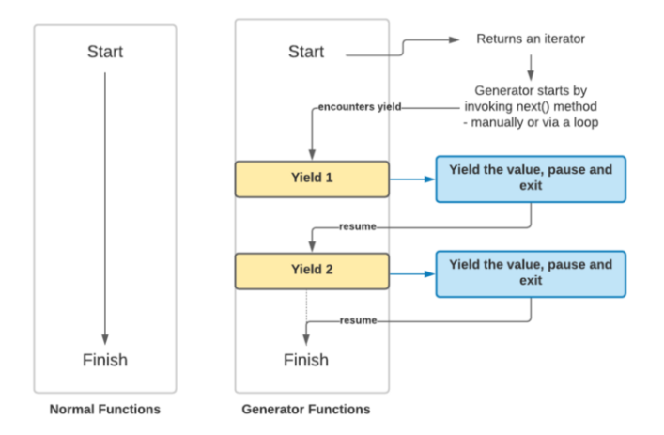

Slide 346
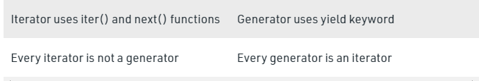
Difference between Iterator and generator

Slide 347
Generators
Generator functions once called, returns the Generator object, which holds the entire Generator iterable and can be iterated using next() method.
Every next() call on the generator executes every line of code until it encounters the next yield and suspends its execution temporarily.
Generators are a special type of function in JavaScript that can pause and resume state.
A Generator function returns an iterator, which can be used to stop the function in the middle, do something, and then resume it whenever.

Slide 348
This generator object needs to be assigned to a variable to keep track of the subsequent next() methods called on itself.
If the generator is not assigned to a variable then it will always yield only till the first yield expression on every next().
A generator function is a function marked with the * and has at least one yield-statement in it.
Syntactically they are identified with a *, either function* X or function *X, — both mean the same thing

Slide 349
Generator functions are written using the function* syntax –
Iterators and generators in JavaScript
‘function*’ is a new 'keyword' for generator functions
yield is an operator with which a generator can pause itself
Additionally, generators can also receive input and send output via yield. In short, a generator appears to be a function but it behaves like an iterator.

Slide 350
A generator is a function that produces a sequence of results instead of a single value, i.e you generate ​a series of values
The value property will contain the value.
The done property is either true or false.
When the done becomes true, the generator stops and won’t generate any more values.
The yield is a magical keyword that can do more things other than simply return a value and next() can do more things aside from retrieving the value.
A passing argument to next() - The argument passed to next() will be received by yield –
Iterators and generators in JavaScript

Slide 351
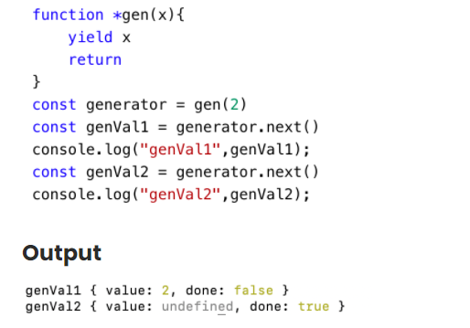

Slide 352
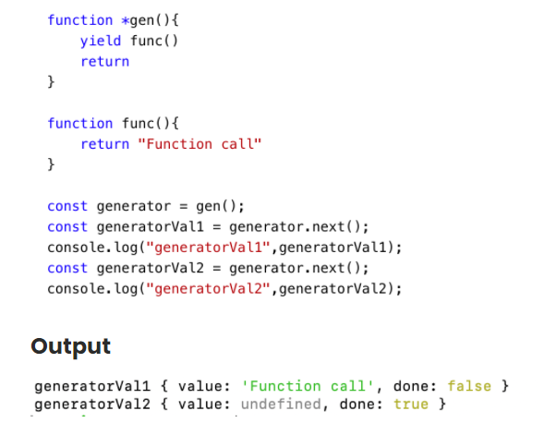
Passing a function to yield
Apart from returning values, the yield can also call a function –

Slide 353
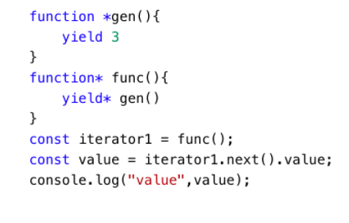
Delegating to another generator or iterable using yield* expression
Iterators and generators in JavaScript
Output
3

Slide 354
const Iterable = {
[Symbol.iterator]() {
let step = 0;
const iterator = {
next() {
step++;
if (step === 1)
return { value: 'Example', done: 'false' }
else if (step === 2)
return { value: 'for', done: 'false' }
else if (step === 3)
return { value: 'Iterator', done: 'false' }
return { value: undefined, done: 'true' }
}
};
return iterator;
} }

Slide 355
var iterator = Iterable[Symbol.iterator]();
iterator.next() // {value: 'Example', done: 'false'}
iterator.next() // {value: 'for', done: 'false'}
iterator.next() // {value: 'iterator', done: 'false'}
iterator.next() // {value: undefined, done: 'false'}

Slide 356
Making objects iterable
So as we learnt in the previous section, we need to implement a method called Symbol.iterator.
We will use computed property syntax to set this key.
const array = ['a', 'b', 'c', 'd', 'e'];
const iterator = array[Symbol.iterator]();
const first = iterator.next().value
iterator.next().value // Since it was skipped, so it's not assigned
const third = iterator.next().value
iterator.next().value // Since it was skipped, so it's not assigned
const last = iterator.next().value

Slide 358
Iterators improve efficiency by letting you consume a list of items, one at a time, similar to a stream of data.
Generators are a special kind of function capable of pausing the execution. Invoking a generator allows producing data in chunks (one at a time) without storing it in a list first.

Slide 359
What is an Iterator and how does it work?
There are many ways to loop through a data structure in JavaScript.
For example, using a for loop or using a while loop. An Iterator has similar functionality but with a significant difference.
An iterator only needs to know the current position in the collection as opposed to other loops where they require to load the entire collection upfront in order to loop through it.
Iterators use the next() method to access the next element in the collection. However, in order to use an Iterator the value or data structure should be iterable.
Arrays, Strings, Maps, Sets are some of the iterables in JavaScript.
A normal object is not iterable.

Slide 360
Why is Iterator better than a normal for loop?
Iterators are better in some cases.
For example, in ordered collections such as Arrays, with no random access, Iterators perform better as they can retrieve elements directly based on the current position.
However, for unordered collections, since there is no sequence, you cannot experience a major difference in performance.

Slide 361
Then, why do we need Iterators?
Remember, using a normal looping algorithm, such as for loop or while loop , you can only loop through collections that allow iterations. Let’s look at an example.

Slide 363
Since an Array is iterable, using the for loop to traverse through the list possible.
We can implement an iterator for the above as well, which will allow better access to elements based on the current position, without loading the entire collection.
Implementing an iterator to the above would be as follows.

Slide 365
The next() method will return the Iterator result.
This consists of two values; the element in the collection and the done status.
As you can see, when the traversing is complete, even if we access an element out of the bounds of the array, it won’t throw an error.
It would simply return an object with a undefined value and a done status as true .

Slide 366
A Generator is
A function that generates a series of values instead of a single value and can pause and resume when required during the execution.
function* is the syntax used to write generator functions.
It includes an operator called yield which allows pausing the generator function itself until the next value is requested.
example of a generator would be as follows.

Slide 367
How does a Generator function differ from a normal function?
As we all know, a normal function cannot pause until its execution is completed. The only method to break out of a normal function would be to use the return keyword.
The following diagram gives a high-level picture of the difference between a normal function and a generator function.

